Slide 1
CASE STUDY
Little Theatre & Little Restaurant
Poland
Company Name, Country
Little Theatre & Little Restaurant, Poland
The little Restaurant is a small, cozy bistro that has existed on the map of Szczecin since 2006, located in a downtown tenement house. It is also the intimate stage of the Little Theater. A few tables, atmospheric music, fresh flowers, on the walls photos from plays and theater posters. In front of the entrance, during the summer, there is a covered garden where you can drink something refreshing and snack on a quick lunch. This is the only restaurant in Szczecin, combining the presence of an intimate stage and a restaurant, where in one building we can watch a performance and in a moment talk about it over a glass of good wine.
Spotkać można tu artystów szczecińskiej sceny, odpoczywających w przerwie między próbami przy porannej kawie czy smacznym lunchu.
Industry, Number of Employees
Restaurant,
D&I Strategy
e.g., Business Culture Development
Module Topic
e.g., Module 4 Empowering Employees
and D&I Culture Development
Website
Insert Link
https://wspolczesny.szczecin.pl/pl/teatr-maly

Slide 2
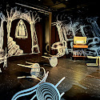
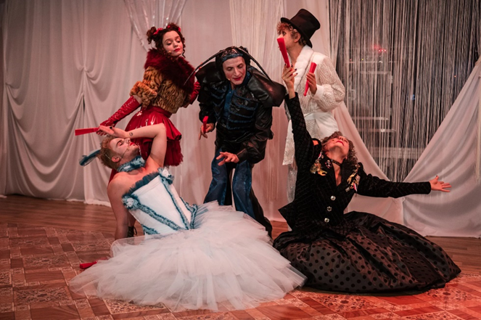
Culture of Diversity
The Little Restaurant, together with the Little Theatre, is not only an institution, theatre is first and foremost a meeting - that is why, especially today, it cannot be indifferent to what is around. We believe that the strength and power of culture lies in the dialogue held with the audience and the program presented on stage. We are not afraid to talk about equality, social injustice, human rights. We create theater that touches on socially important topics. We treat the stage as a place of representation for minorities and excluded groups, the performance as a ritual that creates a new community, and the audience is our experts, participants and greatest source of inspiration.

Slide 3
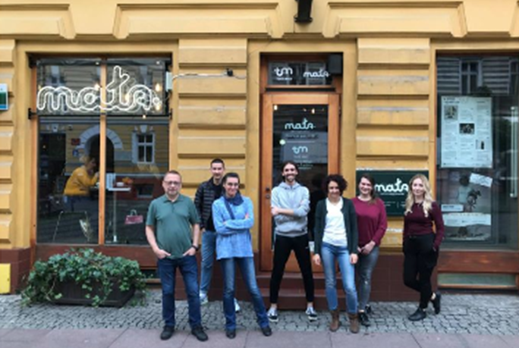
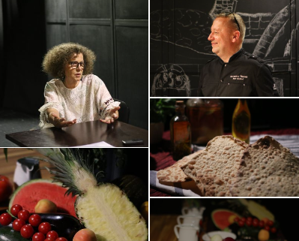
Why is it Important for SME Businesses to Invest in D&I?
Employees pay a lot of attention to what the work climate is like, whether they feel comfortable at work, whether it is their environment - they also build our image. Therefore, in the perspective of development and changes in the market of employees and customers, it definitely pays to build an employee-friendly culture, not just an organizational one. A diverse environment teaches us to understand and tames us with otherness. There are no perfect or identical people.
How has Implementing D&I Benefited Your Company and Employees?
The D&I strategy has been embedded in the essence of the operation of the Restaurant and Little Theatre in Szczecin since its inception. Multiculturalism translates into the development needed in any business.
Thanks to multiculturalism, we broaden our horizons, learn about new cultures and traditions and build openness to other people. It's also a chance to break stereotypes and prejudices, through direct contact and exchange of experiences between different social groups. For places like the restaurant, this is a development in itself.

Slide 4
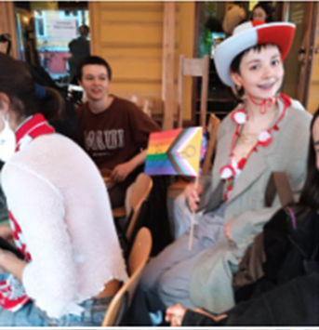
„Rainbow Small Theatre”
The project "Rainbow Small Theatre - a series of events presenting queer culture" is moving into the implementation phase in 2024!
There is also rainbow in the kitchen. Theatre and kitchen together? Absolutely! The culinary evening inspired by the performancee combined these two, seemingly separate worlds.
These are just some of the numerous initiatives conducted by the Small Theatre and the Small Restaurant.

Slide 5
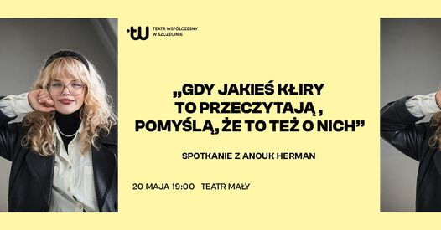
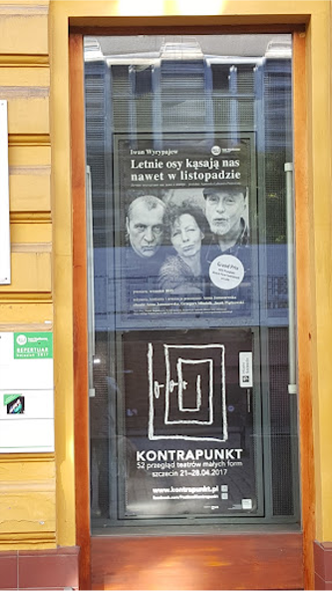
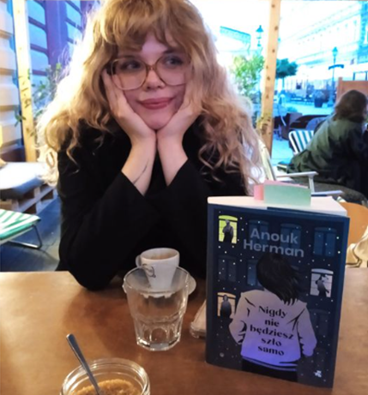
Meetings…
There's something going on at the Theatre... Always
On a certain Sunday morning, Nina Khyzhna, the director of the play "I'll Tell You Tomorrow", conducted movement workshops in Ukrainian! It was a great idea to reach and encourage people from the local Ukrainian community interested in performative practices!
On May 17th this year they celebrated the International Day Against Homophobia, Transphobia and Biphobia supporting such events with all their hearts.
Lately , there was a meeting organised with author Anouk Herman - a non-binary person at the Little Theatre Small Restaurant. The talk will be about the book – “Nigdy nie bedziesz szło samo” (eng. “ *It will never walk alone”)
Clic to type

