Slide 1


CASE STUDY
Hodson Bay Group, Ireland
Company Name, Country
Hodson Bay Group, Ireland
Industry, Number of Employees
Established in 1992, Hodson Bay Group is an Irish family owned business with over 25 years of expertise in Property Development, Property Management and Hospitality. In 2016, they were the first Hotel Group to win the prestigious Platinum Deloitte Best Managed Companies Award for excellence.
The family owned Hodson Bay Group enjoys the flexibility to continually review and refine its facilities and processes. The group broader vision, organisational structure and approach has gained them widespread recognition and positions them well for growth both nationally and internationally.
Customer centred approach and excellent staff is what the hotels are renowned for. Respect for customers, respect for one another and respect for the local community is at the core. All staff from directors to operations work by these three pillars of respect. They believe that great people make great hotels.
Hospitality, 201 - 500 Employees
D&I Strategy
Recruitment & Retention Strategies
Module Topic
Module 2 Leadership and Leading by Example
Website
https://www.hodsonbaygroup.com
www.projectdare.eu

Slide 2
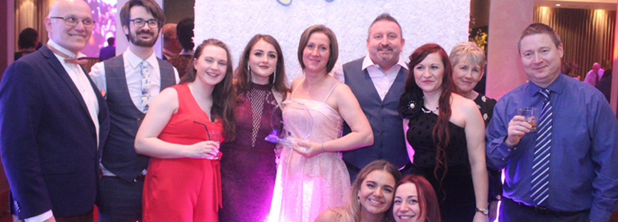
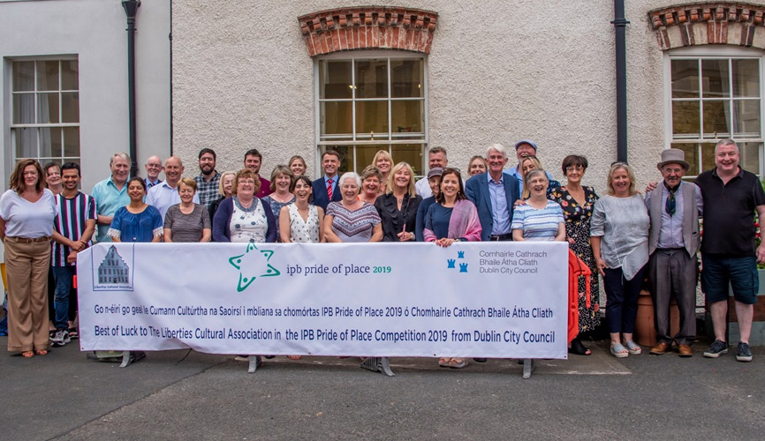
5. Community Engagement and Corporate Social Responsibility: Hodson Bay Group actively engages with the communities in which they operate, supporting local initiatives that promote diversity and inclusion. They are involved in various corporate social responsibility programs that reflect their commitment to making a positive impact on society
6. Guest Experience: The group ensures that their diversity and inclusion values extend to their guests as well. This includes creating a welcoming environment for all guests, regardless of their background, and ensuring that their services are accessible and inclusive.
7. Specific Initiatives and Actions
While the specific initiatives may evolve, the Hodson Bay Group has been known to:
Partner with local organizations to support diversity in the hospitality industry.
Participate in industry-wide diversity and inclusion initiatives.
Regularly review and update their policies to ensure they align with best practices in diversity and inclusion.
https://www.hodsonbaygroup.com/culture/
Staff Celebrations
Each year Hodson Bay Group creates a Staff Celebration Night to celebrate their successes over the past year. It is a great way to create memorable staff moments and includes exceptional food, fun, dancing and laughter. This annual celebration strengthens staff bonds and allows new staff members to meet others from various departments.
Hodson Bay Group:
Diversity & Inclusion Strategy
Hodson Bay Group's Diversity and Inclusion Strategy
Inclusive Workplace Culture: The Hodson Bay Group is committed to creating a work environment where all employees feel respected and valued. This includes promoting a culture where diversity is embraced, and differences are seen as strengths that contribute to the overall success of the company.
Employee Training and Development: The group provides training programs aimed at increasing awareness of diversity and inclusion. This includes training on unconscious bias, cultural competence, and inclusive leadership. These programs are designed to help employees at all levels understand the importance of diversity and how to contribute to an inclusive workplace.
Diverse Recruitment Practices: Hodson Bay Group strives to attract and retain a diverse workforce. This includes implementing recruitment practices that are fair and inclusive, ensuring that job opportunities are accessible to people from various backgrounds, including different ethnicities, genders, ages and abilities.
4.Support for Underrepresented Groups: The group is committed to supporting underrepresented groups within their workforce. This includes creating opportunities for career advancement and leadership development for individuals from diverse backgrounds.
Notes:
https://www.hodsonbaygroup.com/culture/

Slide 3

.’
LEADERS IN THE WORKPLACE
Group Culture
The culture running through Hodson Bay Group creates a positive welcoming environment for all employees. Hotel locations provide high standards of living and recreation for all walks of life. The group encourage balance between work and living with social and recreational incentives fostering balance and healthy culture.
Hodson Bay Group has been named one of the Best Workplaces™ in Hospitality in Ireland 2024! The group Congratulated and thanked all staff for their dedication to creating a great employee experience.
The culture at the Hodson Bay Group is rooted in values of respect, community, and continuous development. As a family-owned business, the group emphasizes creating a welcoming and inclusive environment where both employees and guests feel valued.
This culture is driven by three core pillars: This culture of respect, community focus, and development is central to the group's operations and is reflected in their daily interactions with both staff and guests.
Respect for Our People
Respect allows for the smooth operation and running our processes and services and procedures within our organisation. We encourage a culture of respect across all staff, from the Directors to Operations. In turn, our customers and wider audience experience see and feel our personable, friendly and flexible service
Source: Hodsonbaygroup.com/culture

Slide 4
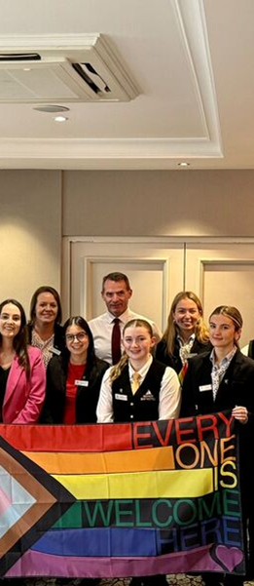
The Hodson Bay Group teams recently celebrated Pride Month with a delightful afternoon tea ( Compliments to their incredible Chefs! )
Group Culture
01
Community Engagement: The Hodson Bay Group is deeply connected to the local communities where its hotels are located. They engage in various community activities and initiatives, reflecting their commitment to social responsibility.
.
Continuous Development: The group believes in investing in its people through training and development programs. They offer career progression opportunities tailored to individual ambitions, ensuring that employees have the support they need to grow professionally. This culture of respect, community focus, and development is central to the group's operations and is reflected in their daily interactions with both staff and guests
02

Slide 5

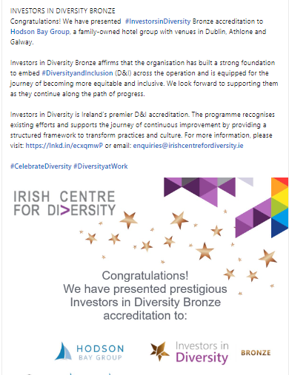
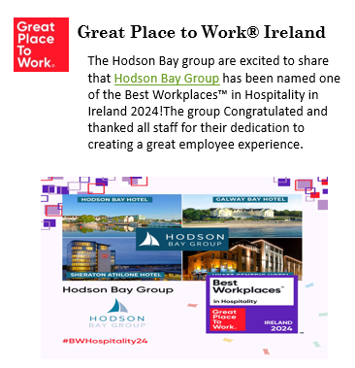
Hodson Bay Group received Investors in Diversity Bronze accreditation from the Irish Centre for Diversity.
Diversity and Inclusion plays an important role in how the group interacts with their people. The Hotel Group looked forward to continuing to work with the Irish Centre for Diversity to embed best practice Diversity, Equality and Inclusion policy.
https://www.linkedin.com/posts/hodson-bay-group_we-are-thrilled-to-have-received-investors-activity-7138847898774966273-QNlF

Slide 6




Hodson Bay Group welcomed Minster Heather Humphries in July 2024 to launch the new #WorkandAccess scheme. Hodson Bay Group were chosen as the venue for the launch because of their reputation as a leader in the area of inclusive employment across their hotels. Schemes like Work and Access encourage and support more employers to engage with local and national organisations that advocate for employment opportunities for people with disabilities.
https://www.linkedin.com/posts/hodson-bay-group_workandaccess-activity-7225099359766355972-wri7
www.projectdare.eu
Follow our journey
This resource is licensed under CC BY 4.0

