Slide 1
DBFL
CASE STUDY
DBFL Consulting Engineers,
Ireland
Company Name, Country
DBFL Consulting Engineers, Ireland
Industry, Number of Employees
DBFL Consulting Engineers, is a fully Irish-owned firm specializing in the planning, engineering design and delivery within the property, infrastructure, environmental & energy sectors. DBFL have a deep connection with their clients and the communities they serve.
DBFL is dedicated to delivering innovative, resilient and sustainable engineering solutions. The core values of sustainability, Integrity, Adaptability, Excellence, Innovation, and Inclusivity—are the foundation of everything DBFL do, guiding their approach to each project and helping to stay true to their mission of Engineering Sustainable Futures.
Engineering, 145 Employees
D&I Strategy
Promoting Diversity and Inclusion Through Partnership & Community Engagement
Module Topic
Module 6 Engaging with Communities and Partnerships
Website
https://www.dbfl.ie/
www.projectdare.eu

Slide 2
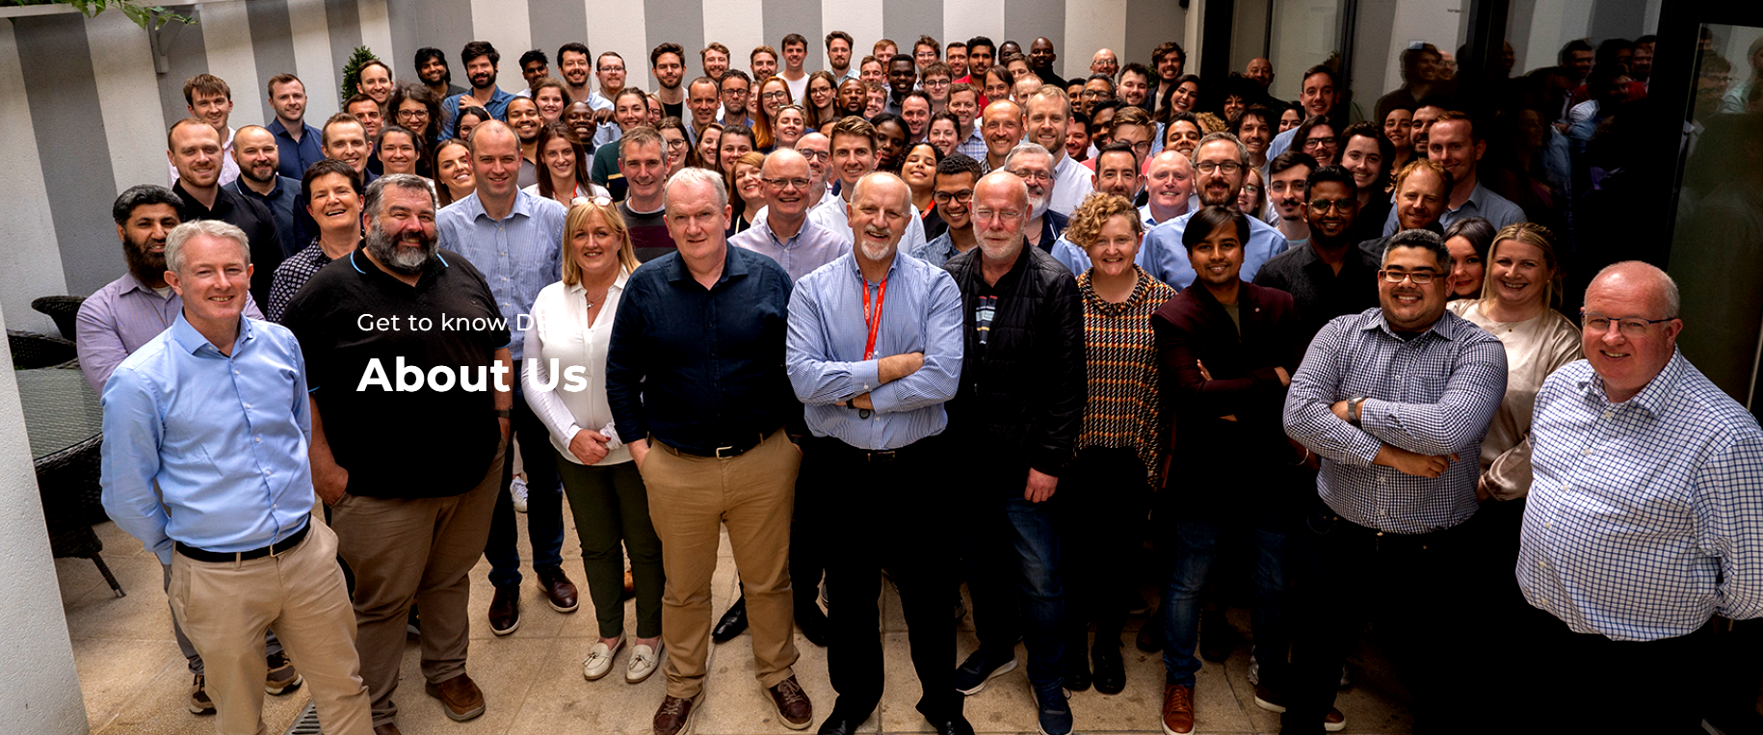
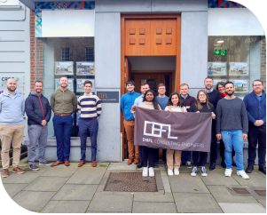
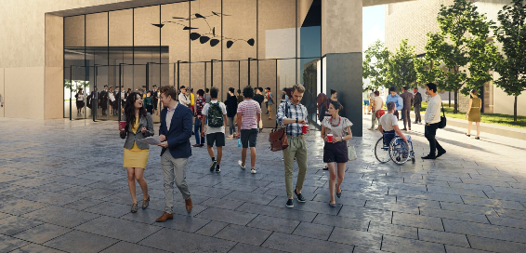
What We Do
Expert Planning
DBFL transport planners provide sustainable travel advice to support the development and operation of modern campuses such as Grangegorman (TU Dublin), Trinity College & Hollyhill in Cork to name but a few. They utilize the latest digital technology to collect data, process and review. GIS is a cornerstone of their transport planning work and DBFL are nationally recognized as industry leaders in this space.
At the core of their work is the delivery of sustainable transport infrastructure which is key to the achievement of national climate change targets.. This ranges from strategic public transport corridors to nationally significant greenway projects. Their industry leading transportation professionals allow the delivery of their mission of Engineering Sustainable Futures.
Constantly Innovating
Our transportation team constantly innovates and evolves to meet the modern needs of society while influencing the sustainable travel agenda. Our teams are continuously developing comprehensive and sustainable mobility strategies for towns, cities and regions, using the latest modelling and simulation technologies to promote well-balanced, multi-modal solutions.
Our model outputs are also used to inform air quality and noise pollution considerations which have an impact on our environment.
The DBFL Way
DBFL are consulting engineers providing multidisciplinary services and solutions to their clients throughout the built and natural environment. ‘”The DBFL Way” is grounded on the principles of partnership, excellence, integrity, and innovation. They are both responsive and ‘hands-on’ in the field of civil, transportation and structural engineering. DBFL encourage and foster creativity to solve complex engineering challenges.
Their dedicated teams focus on client satisfaction, sustainable solutions, and professional development to ensure their projects are successful and ‘make a difference’. The DBFL Leadership Team is actively involved in their projects, working closely with team leaders, technical staff and planners on all aspects of project delivery. They partner with clients and treat their projects and goals like their own.
Sustainable Development
DBFL expanding portfolio includes campus development infrastructure including airports and logistics hubs. Future energy related projects are also now part of our offering. DBFL civil engineering teams have provided expert advice and services on the restoration of old transport corridors such as the Ulster Canal in Clones.
With a strong emphasis on sustainability, they strive to ensure that infrastructure they design contributes to national environmental protection and climate action goals. This includes promoting the use of green technologies, reducing carbon emissions, and incorporating climate resilience into the design and construction of new infrastructure.

Slide 3
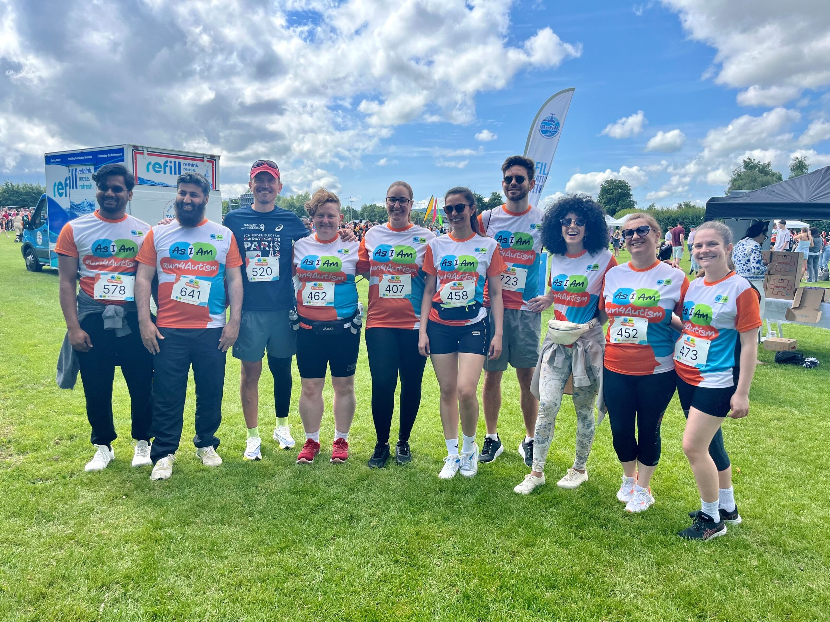
Promoting Diversity and Inclusion Through Partnership & Community Engagement
“We are so proud to announce that DBFL is sponsoring the Advancing Gender Equality Award in the NATIONAL DIVERSITY & INCLUSION AWARDS 2025 Appreciating Ireland’s D&I excellence”
https://www.dbfl.ie/sponsoring-advancing-gender-equality-award/
DBFL Wins Dragon at the Docks Category - August 2024
DBFL concluded Disability Pride Month with a memorable event: the 5k Run4Autism, held on Sunday 28th July, in the sunny Corkagh Park. Organised by AsIAm, this annual event, now in its 6th year, plays a vital role in raising funds to support their mission of providing comprehensive information about autism and creating a supportive platform for individuals and families in the autism community.
This year’s Run4Autism saw an impressive turnout, with nearly a thousand enthusiastic participants coming together for the cause. DBFL proudly fielded a team of 12 dedicated runners, walkers and their supporters who actively fundraised for the event, showing their support for autism awareness.
DBFL At Run4Autism 5k Run - July 2024
DBFL concluded Disability Pride Month with a memorable event: the 5k Run4Autism, held on Sunday 28th July, in the sunny Corkagh Park. Organised by AsIAm, this annual event, now in its 6th year, plays a vital role in raising funds to support their mission of providing comprehensive information about autism and creating a supportive platform for individuals and families in the autism community.
This year’s Run4Autism saw an impressive turnout, with nearly a thousand enthusiastic participants coming together for the cause. DBFL proudly fielded a team of 12 dedicated runners, walkers and their supporters who actively fundraised for the event, showing their support for autism awareness.
Special thanks to our incredible Diversity and Inclusion team for all their efforts in organizing the team and rallying participation.
By participating in the Run4Autism, DBFL contributed to a worthy cause. The funds raised through this event will enable AsIAm to continue their invaluable work, providing resources, support, and advocacy for the autism community.

Slide 4
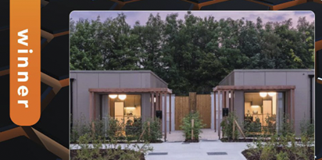
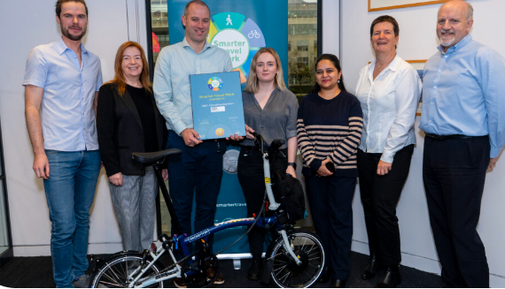
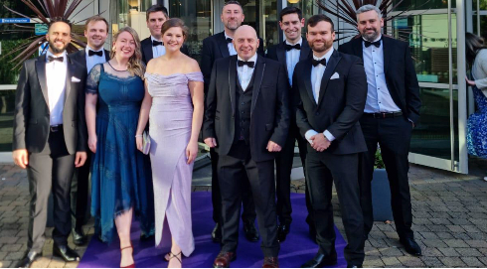
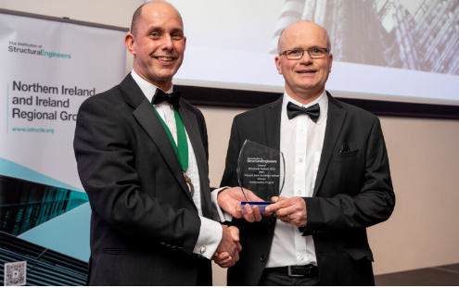
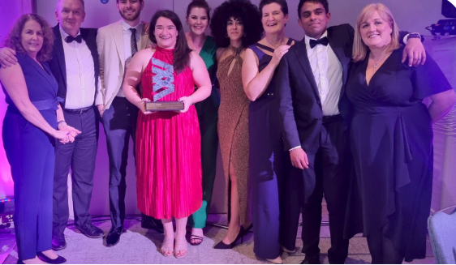
DBFL achieves Gold Smarter Travel Mark
A great testament to THE dbfl smarter travel options in their four offices, DBFL was one of the first ten companies to be awarded the Gold Level Smarter Travel Mark from the National Transport Authority, recognising that the company has “outstanding measures that support sustainable and active commuting”. At DBFL, we pride ourselves in ‘practising what we preach’ in terms of sustainable travel.
DBFL Wins IStructE Conservation Award
DBFL won the Conservation Award for our Primark Bank Buildings Belfast project at the Institution of Structural Engineers inaugural Irish awards. DBFL engineers helped devise some amazing engineering innovations to overcome the unique complexities and challenges of this dramatic resurrection project.
AWARDS 2024
Irish Construction Excellence Winner
A great win for the multi-site Ukrainian Rapid Modular Homes project with John Sisk & Son Ltd and the Office of Public Works Winner of the Innovation in Construction category at the Irish Construction Excellence Awards 2024.
Cork Business of the Year Award
DBFL’s Cork office won the esteemed 2024 Cork Business Association (CBA) Business of the Year Awards in the ‘Best Professional Services’ category, a well-deserved accolade for a great team.
National Diversity & Inclusion Awards
DBFL were super proud of Christina Haney for winning Employee of the Year, at the National Diversity and Inclusion Awards 2024. These comments from the judging panel say it all. “Christina excels not only in her profession but also as a dedicated advocate for D&I. She’s a pivotal member of the D&I Employee Resource Group, driving inclusion both across an intersection of domains.”

Slide 5
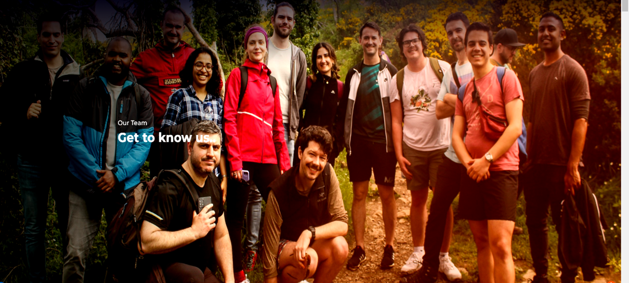
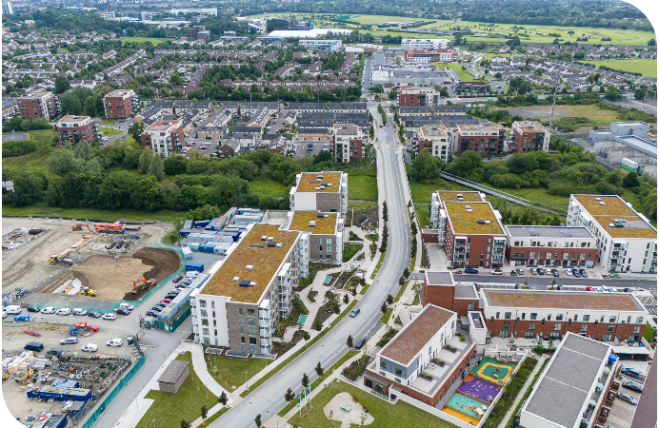
Sustainability at DBFL - in their own words
Sustainability
Sustainability is at the heart of everything we do. We believe that every project offers an opportunity to drive environmental efficiencies. From project concept to completion, DBFL integrates environmentally-friendly practices and cutting-edge technologies to minimize environmental impact while maximizing efficiency, quality and longevity.
Our commitment to sustainability ensures that we deliver solutions that are not only effective today but also beneficial for future generations. We strive to influence sectors & policy makers with what we do.
The The ACEI Pledge
At DBFL we take our responsibility within the industry seriously. We are signatories to the ACEI Pledge to Net Zero campaign, and members of the Irish Green Building Council and their EPD Campaign. These initiatives are
driven by our staff who are passionate about tackling the climate emergency and affecting change in how we design, but also in how we conduct our business responsibly. We are involved with Construct Innovate working groups and active members of MMC Ireland.
Our environmental management systems are ISO 14001:2015 certified.

Slide 6
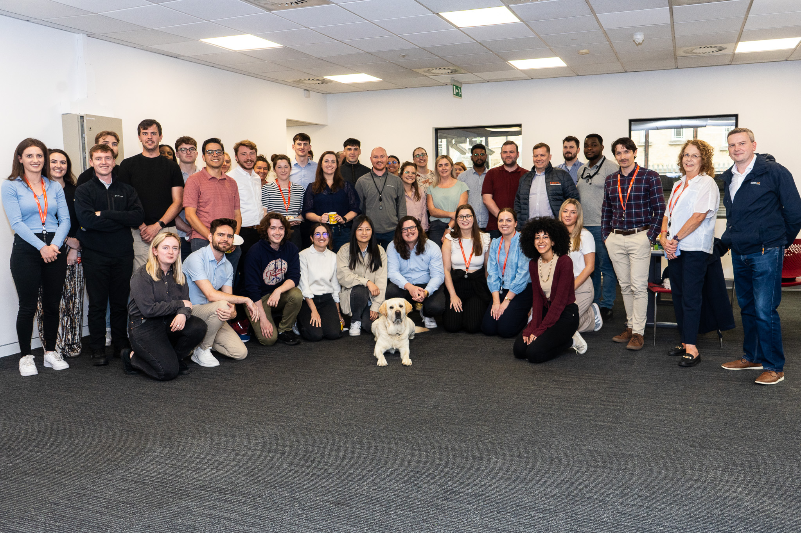
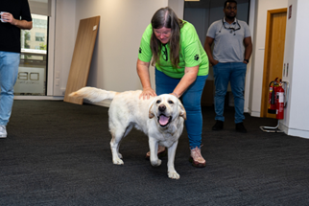
Irish Guide Dogs For the Blind - 26 July 2024
DBFL had a great visit from a very good boy, Zaid the labrador, with his handler Anne in July. They were accompanied by Corporate Partnership Manager, John Burke from Irish Guide Dogs for the Blind.
Their visit highlighted the impact these specially trained animals have on the lives of those they assist. Anne and John shared insights into the training process and the incredible bond they form with these remarkable dogs. The event was made possible by our Diversity & Inclusion team, who organised this gathering to raise awareness about the vital work of Irish Guide Dogs for the Blind, while we celebrate Disability Pride Month.
Some lovely cakes which were baked by our volunteers were enjoyed while everyone played with and petted Zaid. DBFI also raised nearly €600, so far for Irish Guide Dogs for the Blind.pe

Slide 7
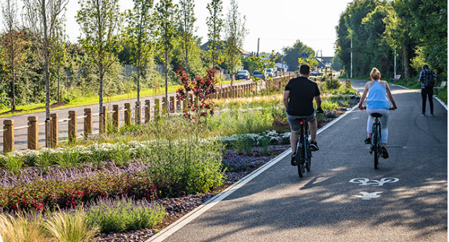
Leaders in Nature-based Strategies
DBFL has introduced a transformative shift in their approach to urban drainage design in response to the climate crisis and their commitment to sustainable engineering solutions. DBFL are leaders in the design of nature-based drainage strategies at regional and site level to mitigate the effects of extreme weather events.
Their design approach focuses on replicating the natural drainage regime while ensuring robust and maintainable systems for their clients and future generations. This approach ensures the functional requirements of on-site drainage systems are achieved while also respecting the flood protection of downstream assets.
Putting our Commitments into Practice
At DBFL, they pride ourselves in ‘practising what we preach’ in terms of sustainable travel, reflecting the extensive contribution our Transportation teams are making in development and implementation of Active Travel schemes across the country.
In their designs, they encourage all their engineers to consider the environmental impact of their decisions. They aim to help clients and the design team to consider sustainability in their own aspects of a project, to think about using sustainable materials and construction methods wherever possible. By using embodied carbon calculators at concept design stage, they can inform the team of the environmental footprint of each option considered. This information allows them to highlight areas, materials and phases with the biggest environmental impact.
The 3 R’s
Reduce, Reuse and Recycle is a core principle of DBFL designs. Their expertise in soil stabilization, re-use of excavated materials, geosynthetics and recycled aggregates for use in roads, where appropriate, minimises import/export of virgin materials, reduces haulage traffic and disposal to landfill. DBFL designs and commitment to the environment offer significant carbon reductions and increased sustainability.
www.projectdare.eu
Follow our journey
This resource is licensed under CC BY 4.0

