Slide 1



CASE STUDY
,
Ireland
Company Name, Country
Ireland
Fuzion is a fully integrated brand communications agency providing public relations, creative design, digital marketing and impactful storytelling to help clients build their brand and manage their reputation.
All of Fuzion client services, whether it’s arranging a photocall or distributing press materials, designing reports or executing a complete rebrand, crafting communication strategies or launching digital marketing campaigns, shape the way brands are perceived, enhancing reputation through effective communication.
With an ‘always on’ approach Fuzion devise, create and activate unique communication strategies across multiple channels. From traditional PR to social media delivering creative campaigns that get results
Industry, Number of Employees
Advertising Services, 11-50 Employees
D&I Strategy
Marketing Strategies
Module Topic
Module 5 Marketing Strategies that Promote Diversity and Inclusion
Website
http://www.fuzion.ie
www.projectdare.eu

Slide 2
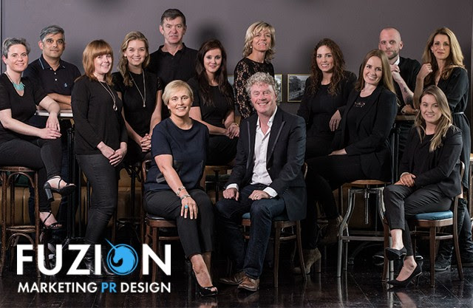

In own words
Communications & Strategic Planning
“Central to our strategy is ensuring consistency across all communication touchpoints. Whether it’s press releases, social media posts or internal memos, we maintain a unified voice and messaging framework that reinforces brand’s credibility and reliability”
Fuzion also prioritise proactive communication to anticipate and address potential issues before they escalate. “Our crisis communication plans are designed to guide organisations through challenging situations, preserving reputation and maintaining stakeholder confidence”
Measurement and evaluation are integral parts of the process. Fuzion continuously monitor and analyse the effectiveness of communication strategies, adjusting as needed to optimise results and ensure alignment with organisational goals.
Corporate Communications with Fuzion isn’t just about transmitting information; it’s about building relationships and driving success. Crafting clear, cohesive messages that resonate with stakeholders helps organisations navigate the complexities of the corporate landscape with confidence and clarity.
Central to their strategy is fostering a culture of open communication and feedback. Fuzion facilitates two-way communication channels that encourage dialogue between leadership and employees. This ensures that everyone feels heard, valued and empowered to contribute to the organisation’s success.
Measurement and evaluation are integral parts of their approach. “We continuously monitor the effectiveness of our internal communication strategies, gathering feedback and data to inform ongoing improvements and optimisations”
Internal Communications with Fuzion isn’t just about transmitting information; it’s about fostering a culture of collaboration, transparency and engagement. “By providing the tools and support necessary for effective communication, we help organisations thrive in today’s fast-paced business environment”

Slide 3


Marketing Strategies Resulting in National Awards
Commendation from the Public Relations Institute of Ireland (PRII) at the Excellence in Public Relations Awards for our work with Kildare Co Co on Brigid1500. The ‘Brigid 1500’ campaign aimed to create a lasting cultural and societal legacy by honouring St. Brigid, attracting a diverse audience, and boosting tourism to Co. Kildare, Ireland.
Winner of Chambers Ireland National Communications CSR Award and Special Recognition for Excellence in PR by the PRII for our international ‘Safe-book’ anti cyberbullying campaign.
Winner of National Award for Excellence for Public Affairs by the PRII for our work with Down Syndrome Ireland when we represented and fought tenaciously on behalf of the thousands of children with Down syndrome who were in danger
of losing their discretionary medical cards to successfully achieve a Government U-turn.
Winner of Best Public Affairs Campaign at the Awards for Excellence in Public Relations by the PRII for our work with the Cystic Fibrosis Association of Ireland
Shortlisted for a National Award for Excellence in PR by the PRII for our Cycle Against Suicide campaign.
Winner of Chambers Ireland National Communications CSR Award and Special Recognition for Excellence for our international “Safebook” cyberbullying campaign.
The Approach
Corporate Communications is the lynchpin of organisational success. Fuzion, understands its pivotal role in shaping perception, fostering trust and driving business objectives.
Effective corporate communication is necessary for building and maintaining strong relationships with stakeholders – whether it’s employees, investors, customers or the public. It ensures alignment of goals, encourages transparency and mitigates potential misunderstandings or conflicts.
Their approach to corporate communications is a 360-degree approach. They begin by gaining a deep understanding of organisational values, objectives and target audience. From there, they develop tailored communication strategies that resonate with stakeholders and reinforce brand identity.
Their services encompass a range of channels and tactics, from internal communications to external messaging, crisis management and media relations. They craft clear and compelling messages that convey individual organisational vision, values, and achievements.
The Power of Positivity
by Fuzion Blog

Slide 4
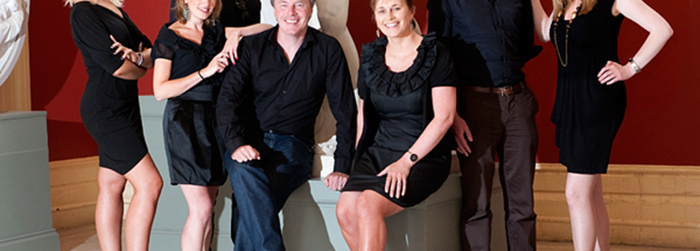
‘With an ‘always on’ approach we devise, create and activate unique communication strategies across multiple channels.’
https://www.fuzion.ie/communications/
Fostering Creativity by Communications Manager at Fuzion
Creativity doesn’t happen in a vacuum. When we create a culture where everyone’s ideas are welcome and encouraged, magic happens. Sharing diverse perspectives, brainstorming together, and supporting each other’s creativity leads to breakthroughs and amazing campaigns and strategies that we are excited to progress.
Overall, creating a positive work environment isn’t just about boosting morale, it’s about creating a thriving ecosystem where employees can reach their full potential, contribute meaningfully to company
success, and find fulfilment in their work.
It’s important that you play your part in creating that positive atmosphere – is there a fertile ground for negativity or is it quickly something that is not given oxygen and it dies out?
As good always wins over bad, positivity always wins over negativity, and it is everyone’s individual responsibility to champion a culture of positivity, collaboration, and growth in the workplace.
Stephanie Stafford is Head of Communications at Fuzion
Effective Communications – Media Training & Interview Preparation
Fuzion understand the fears some organisations hold about getting their media communications wrong but, more importantly, they recognise the opportunities of getting it right by providing Media Training services to carefully equip individuals and teams to deal carefully and confidently with the media, in all circumstances.
The media training team is led by former journalist, Aoibhinn Twomey, whose experience and expertise help make a more polished spokesperson, business leader or elected official.
They have successfully worked with top professionals and CEOs, honing their ability to convey messages clearly and effectively in the public eye.
Fuzion training involves practical insights into media dynamics, equipping organisations with the tools to handle interviews, press conferences, and public speaking engagements. Fuzion go beyond theoretical knowledge, offering hands-on exercises and simulated scenarios to prepare for the unpredictable nature of media interactions.
Key elements of the Fuzion approach include message clarity, succinctness, and adaptability. They emphasise the importance of crafting messages that resonate with target audiences while ensuring they align seamlessly with brand messaging.
https://www.fuzion.ie/media-training-case-studies/

Slide 5

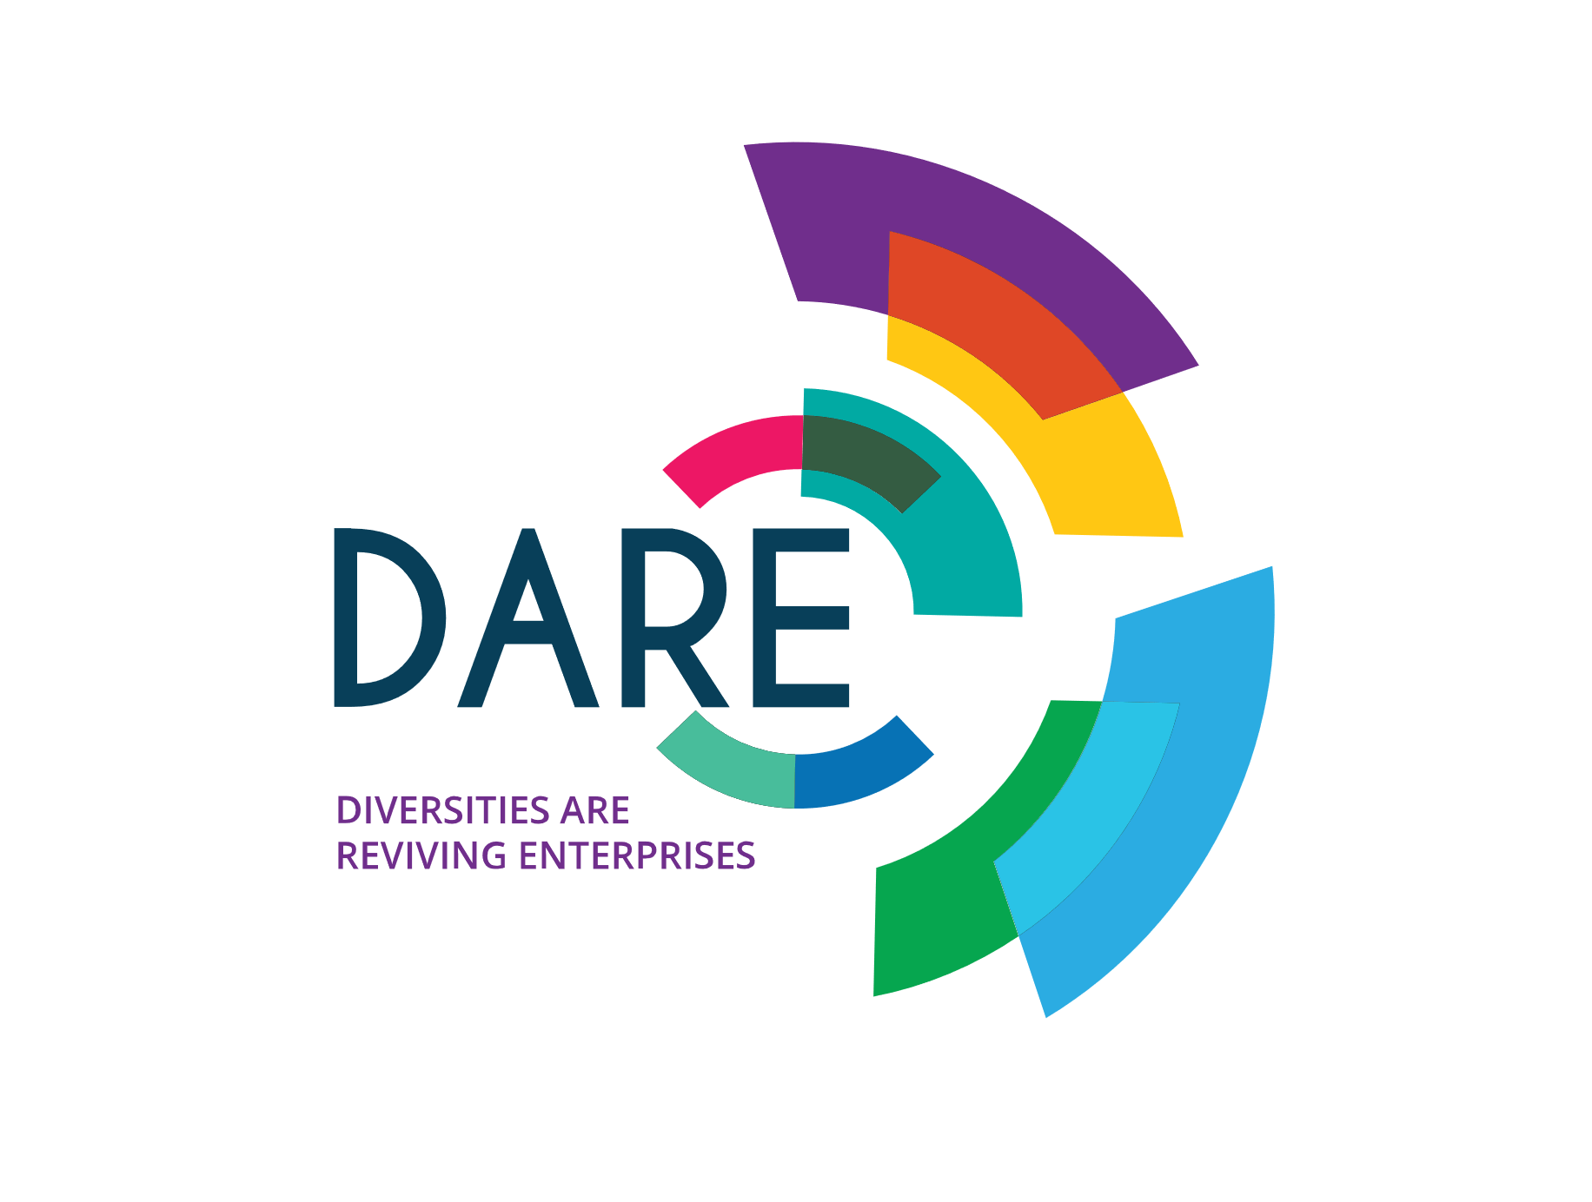







LinkedIn – Group Hug!!
(Are you joining groups?) by Greg Canty
Newsletter
Marketing - Focus on LinkedIn
What Fuzion say;
From my experience most LinkedIn users are not using the very useful ‘Groups‘ facility on the platform. For your industry or your business community there is more than likely a group set up with like minded individuals who have already joined.
These could provide you with the opportunity to interact with like minded people, discuss topical issues, solve problems, demonstrate your expertise, get information or these could easily help you to identify useful connections for your business or organisation.
If you do a search right now…Dublin Chamber, Cork Chamber. UCD Alumni, Marketing professionals, Hospitality professionals in Ireland – you are likely to find a group that matches your search.
Groups will have a filter process for members depending on how they have been created – you will need to request to join or be invited to join by an existing member and an administrator somewhere will decide whether to let you in or not.
If it is a group for a membership organisation it is very likely that they will not grant you access unless you are a member.
When you create a group you have
a number of options including:
Name and description
Industry types (up to 3)
Stated rules for the group (how members should use and behave within the group)
Whether the group is visible or not: you could for example make it a “closed” group for your organisation so it won’t appear on searches
If you allow existing members to invite others to join
Approval setting for posts within the group.
New Feature: Messaging
The functionality is always changing so how you can use them is always changing. For example LinkedIn have just now given members within groups the ability to send a message to other members, without being connected to them (and without having the paid version of the platform).
These messages will come into you just like a normal message on LinkedIn.
So…look for a group today that could work for you and your business, click that ‘Join’ button and off you go! Or…maybe you could be the one to create that group? What are you waiting for?!!
www.projectdare.eu
Follow our journey
This resource is licensed under CC BY 4.0

