Slide 1
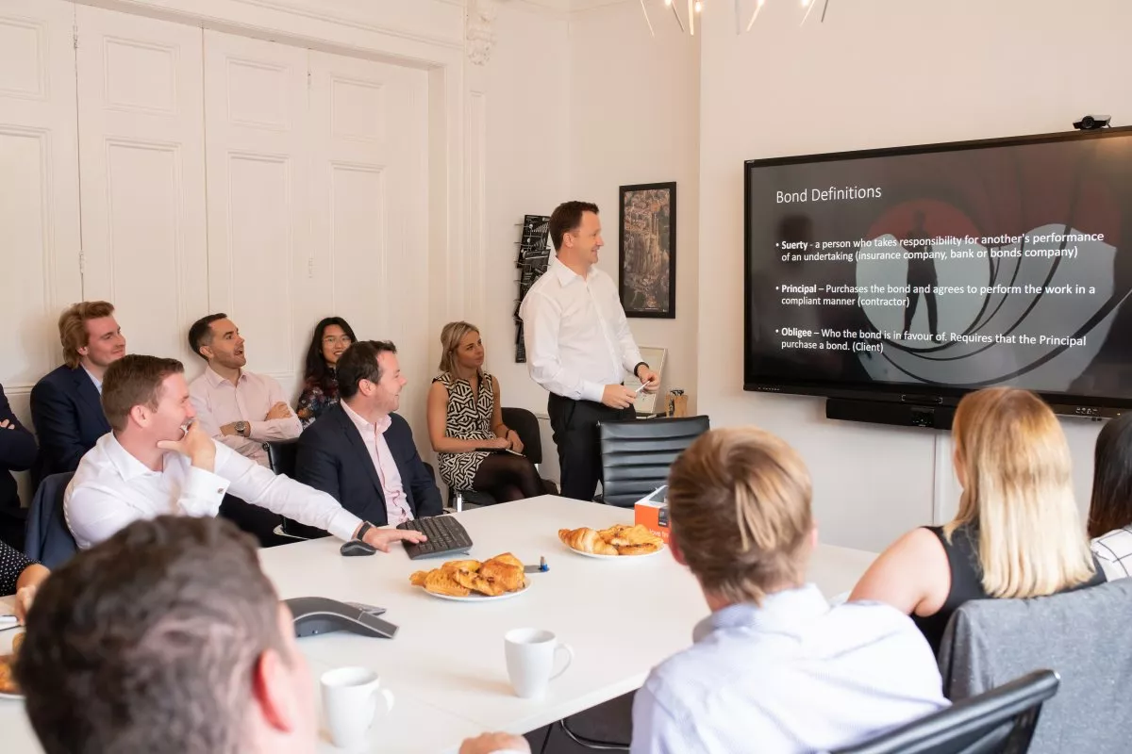
CASE STUDY
Ireland
Company Name, Country
Mitchell McDermott, Ireland
Mitchell McDermott is an independent, full-service and data-led construction consultancy in Ireland that empowers ambitious companies to build better.
With a relentless focus on quality, efficiency and new ideas, the team offer hands-on Quantity Surveying, Project Management, Funder Advisory and Specialist Services. As one of the leading construction consultancy firms, they help clients deliver ever more exciting, practical, and sustainable projects – efficiently and on deadline.
“It is all made possible by our people. We’ve developed a culture of learning and growth that means our team is shaping new ways of working and redefining what’s possible in the industry. And we’re not done yet.”
https://www.greatplacetowork.ie/workplace/item/4576/Mitchell+McDermott
Industry, Number of Employees
Construction: 51 Employees
D&I Strategy
Business Culture Development
Module Topic
Module 4: Empowering Employees and D&I Culture Development
Website
https://mitchellmcdermott.com/
www.projectdare.eu

Slide 2
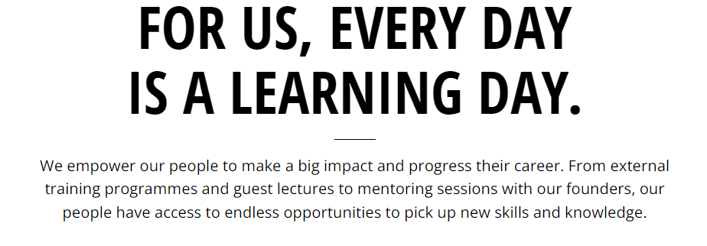
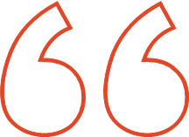
Culture of Diversity: Investors in Diversity Bronze Accreditation Achieved by the Mitchell McDermott Organisation
Mitchell McDermott is proud to have achieved ‘Investors in Diversity’ Bronze Award. Bronze is the first of the three stages in the Investors in Diversity EDI Mark, and recognises our commitment to embedding Equality, Diversity and Inclusion in our company’s systems.
The Investors in Diversity programme is Ireland’s only D&I accreditation mark, and provides a framework to put in place a strong foundation to build our EDI, using best practice models and the ability to measure our progress on the journey.
Diversity expresses itself in many ways – in age, gender, race, nationality, culture, marital status, sexual orientation, religion, belief, education, disability, personality, neurodiversity, life experiences and approaches to work.
Mitchell McDermott as a company aims to maximise the potential of its people, by harnessing these differences and creating a productive environment in which everyone feels respected and valued, where their talents are being fully utilised and in which organisational goals are achieved.
https://mitchellmcdermott.com/careers/
What Inspires the team?
Company Culture
Our company culture is one that is bought into by everyone from the newest Intern to the Directors. It’s living and breathing our Core Values. The leaders of the company ensure that every employee understands the expectations and acts accordingly. Our company culture is one that inherently promotes curiosity, respect, teamwork and employee health.
For us, every day is a learning day
We empower our people to make a big impact and progress their career. From external training programmes and guest lectures, to mentoring sessions with our founders, our people have access to endless opportunities to pick up new skills and knowledge.
Rewards, Recognition & Celebrations
Whether it’s a housewarming gift, or baby clothes to welcome a new arrival, we enjoy recognising and celebrating the special life events of our team. New ideas that improve how we work are acknowledged and rewarded, as well as professional achievements such as Chartership.
Working Groups
Our Core Values are really reflected in the diverse topics covered by our 14 Working Groups. Each group is employee-led, giving everyone from placement students and graduate to directors the chance to be active in an area that interests them personally, and make a vital contribution to helping our company be the best it can be. ​
https://mitchellmcdermott.com/careers/

Slide 3
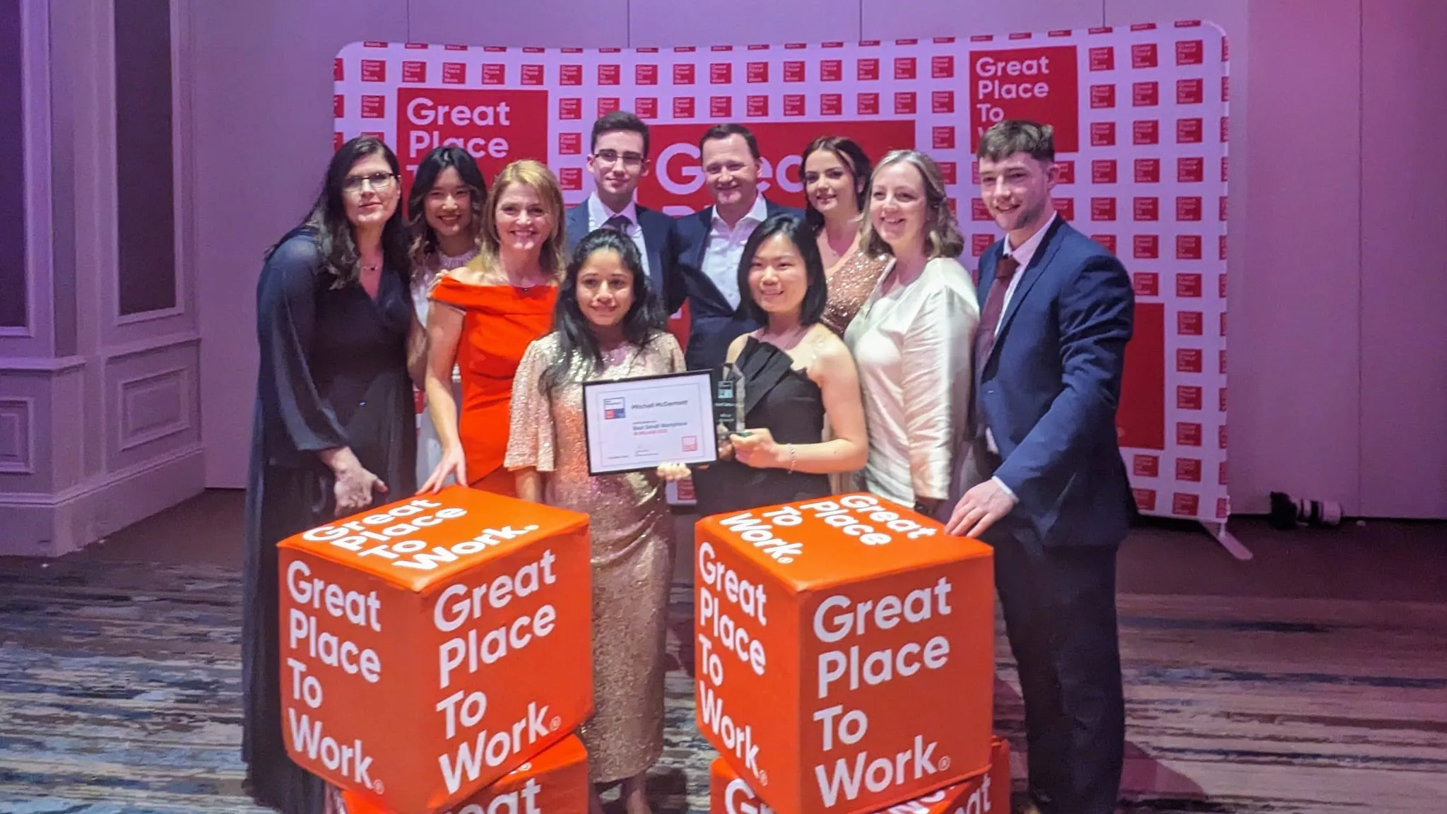
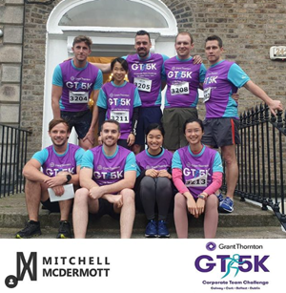
“We empower our people to make a big impact and progress their career. From external training programmes and guest lectures to mentoring sessions with our founders, our people have access to endless opportunities to pick up new skills and knowledge”
https://mitchellmcdermott.com/careers /
Organisation Culture: What the People in Mitchell McDermott say …….
EMBRACE THE INDEPENDENT SPIRIT
Exploring new opportunities and making a difference working at Mitchell McDermott.
Culture of Inclusivity at Mitchell McDermott.
Inclusivity is an integral part of the organisational culture in Mitchell McDermott. They believe that an inclusive working environment is one in which everyone feels that they belong without having to conform, that their contribution matters, and they can perform to their full potential, no matter their background, identity or circumstances. Simply put, it means people feel they can be themselves at work.
An effective Diversity and Inclusion strategy not only fulfils legal requirements on equality and non-discrimination, but also adds value to the organisation, contributing to people’s well-being and engagement.

Slide 4
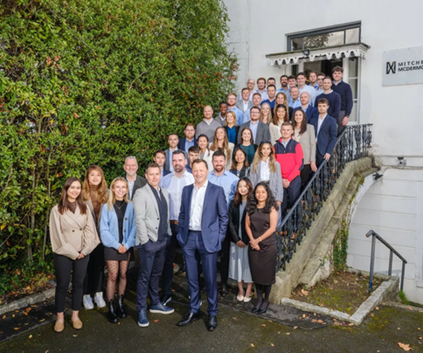
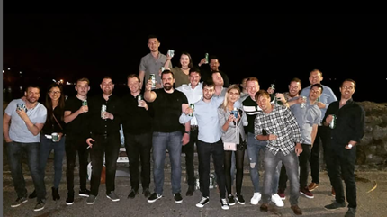
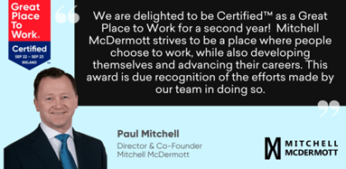
Michell McDermott were thrilled to be recertified as a Great Place to Work in October 2022 and delighted to rank 2nd in Ireland Best Workplaces 2023 for small firms (20 – 100 employees), and 39th in Best Workplaces Europe 2023.
They strive to be a place where people choose to work, while also developing themselves and advancing their careers. This award is due recognition of the efforts made by the team in doing so.
Michell McDermott were thrilled to be recertified as a Great Place to Work in October 2022 and delighted to rank 2nd in Ireland Best Workplaces 2023 for small firms (20 – 100 employees), and 39th in Best Workplaces Europe 2023.
There are lots of things that make Mitchell McDermott unique and a really great place to work, and the key ingredients are: their people; their culture of learning, growth, and innovation; and their focus on quality in all that they do.
They create this unique environment by empowering their people to have a big impact on how the business works, by giving them the ability to contribute and innovate, and fostering an environment where they can grow professionally, personally, and progress their career.
This environment is based on their 5 Core Values:
Not just business – They have fun, care for their people and help others.
Open mind – open door – They encourage questions and build the answer together.
Do the right things – They are guided by their integrity and honesty, regardless of the journey.
Mine data, share knowledge – They empower their people to use data to better serve their clients.
Find better ways – The relentless pursuit of innovation
for their people and their clients
www.projectdare.eu
Follow our journey
This resource is licensed under CC BY 4.0

