Slide 1
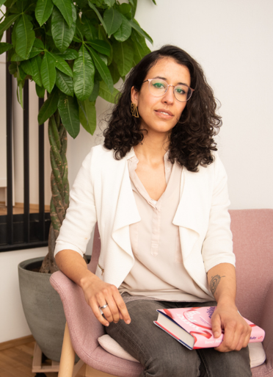



CASE STUDY
Sarah Lutzemann - kohsie
Contact Person
Sarah Lutzemann
Meet Sarah Lutzemann, the visionary behind kohsie, Central Germany's first diversity bookshop, which she opened in April 2022. A unique literary haven, kohsie presents an exclusive collection of books written by women and people from diverse backgrounds from around the world. The curated selection aims to contribute to the visualization and deconstruction of systemic oppression and address issues such as racism, capitalism and patriarchy.
Date of Interview
Title
Company Name
kohsie
www.projectdare.eu
This resource is licensed under CC BY 4.0

Slide 2
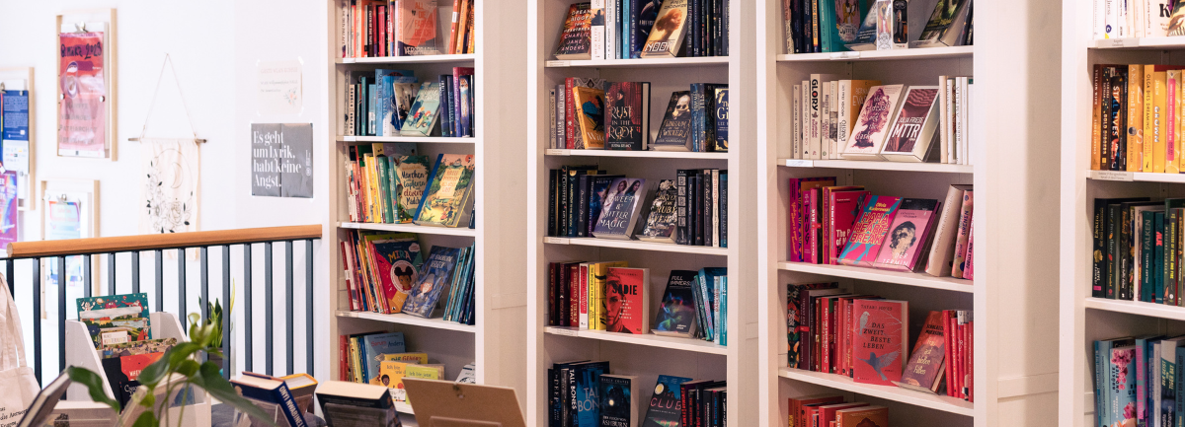
Sarah's founding story
In discussions about literature, there is often a tendency to categorize works as either “male” or “female”, overlooking the fact that some authors do not identify with the binary gender spectrum. This omission highlights the need to broaden our perspective on the representation of gender in literature. Furthermore, it is important to recognize that looking only at white women and non-binary people is not inclusive. This highlights another omission in literary dialogues and emphasizes the importance of recognizing literature by Black and Indigenous authors as well as works written by People of Colour.
Through a more inclusive approach that incorporates the experiences and narratives of writers from diverse backgrounds, we can promote a truly inclusive and representative understanding of literature.
Sarah wants to actively contribute to making the world a better place for everyone. She recognizes the profound impact each book has on readers by influencing their thoughts, perspectives and perceptions of the world. As a dedicated bookseller, Sarah seizes the opportunity to guide and shape this change through her carefully curated selection of literature. Her goal is to promote positive change by exposing readers to thought-provoking books that influence their individual and collective understanding of the world.
Sarah's journey to founding kohsie was driven by her desire for personal fulfillment and her commitment to her values. Before venturing into entrepreneurship, she found herself in a professional environment that was not aligned with her principles and where she was exposed to racism and sexism. Sarah recognized the incongruence between her authentic self and the corporate environment and made the bold decision to embark on the path of entrepreneurship, which ultimately led to the founding of kohsie.
Sarah Lutzemann's inspiration to start a diversity bookshop was partly triggered by a reading challenge she came across at the end of 2019: the task of reading books exclusively by female and non-binary authors for an entire year. This challenge familiarized her with the rich spectrum of perspectives these authors offer and highlighted the wealth of diversity in literature. However, she also made it clear how much effort it takes to discover these voices in the literary landscape. With her bookshop, Sarah wants to facilitate this journey of discovery and offer readers easy access to the wealth of literature by female and diverse authors.

Slide 3


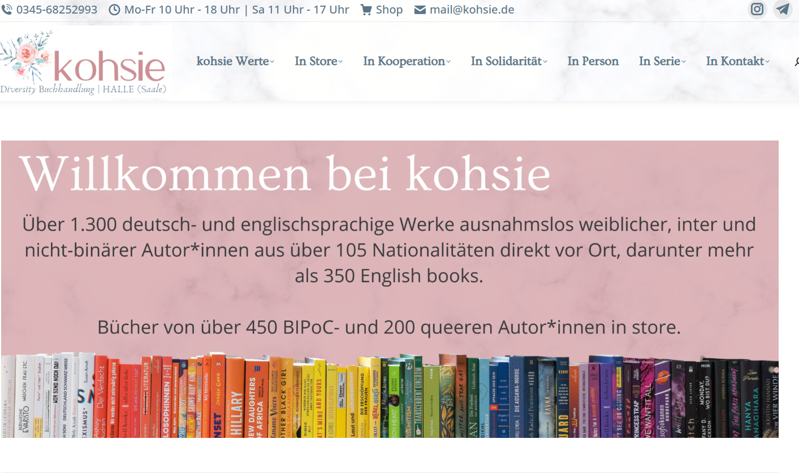

My aim was to show how diverse literature can actually be and how little this has been revealed in other bookshops to date.
- Sarah Lutzemann, kohsie
www.projectdare.eu
Follow our journey
This resource is licensed under CC BY 4.0

