Slide 1
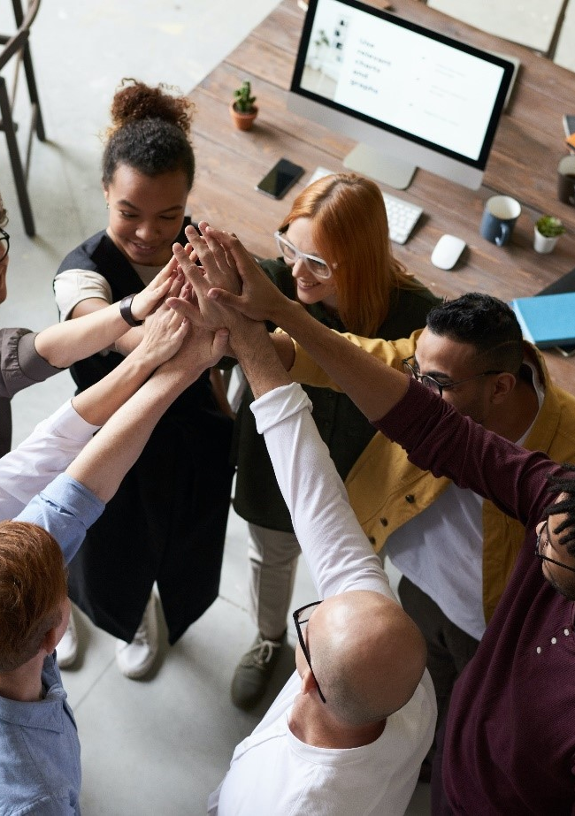
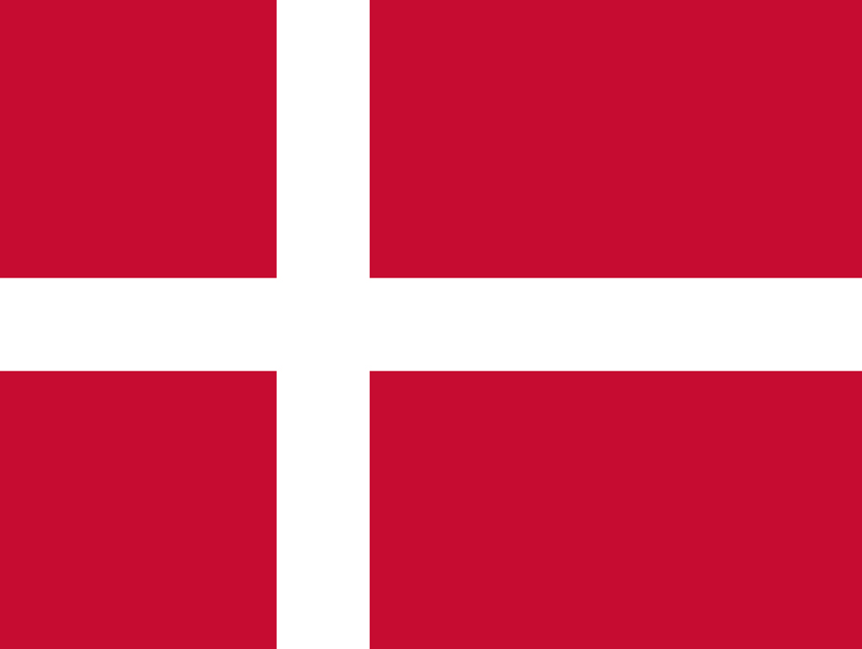

CASE STUDY
Nordea
Company Name, Country
Nordea, Denmark
Industry, Number of Employees
Nordea are a leader in digital banking, with sustainability at the core of their strategy. Nordea’s roots date back to 1820s Copenhagen, when a local savings bank first opened its doors for business. Over time, we have grown to become the leading financial institution in the Nordics, offering a wide range of financial services. Our essential role has always been clear: to help our customers realise their dreams and aspirations, while supporting the development of Nordic societies. Through a recruitment process, the specialists at Specialisterne have helped Nordea find seven employees with diagnoses within the autism spectrum for the bank's automation team.
Banking. 50 + employees
D&I Strategy
Recruitment
Module Topic
Module 3
Recruitment
Website
https://www.nordea.com/en/careers/denmark
www.projectdare.eu

Slide 2

Recruitment
"We entered into the recruitment partnership with Specialisterne for two reasons. Firstly, we wanted to do something for a good cause, and we found that people with autism were someone we really had a good opportunity to help. Secondly, we knew that people with autism can have some fantastic skills within IT, which could also help us.“
"We have a new dynamic in the team. We have colleagues who look at things in a slightly different way and who also force us to think about things in new ways.“
Majbritt Gyldengren, Chief Expert, Nordea Automation
The challenge
Nordea needed to expand its automation team, which builds new services that can be automated and make work easier and faster for Nordea employees. Nordea needed IT employees with different skills. Some would build virtual robots for automation, others would transfer data from the old system to the further development that the automation team was working on. Nordea wanted to use the recruitment to help people with autism enter the job market.

Slide 3
The solution to Nordea’s Recruitment challenge
Nordea entered into a recruitment partnership with Specialisterne. The recruitment process was based on Specialisterne's standard model for recruiting several autistic employees at once to a company, which was adapted to Nordea's needs.
Among the applicants who had responded to the job posting, Specialisterne selected around 30 candidates who were invited to participate in a workshop. Here, a group assignment with, for example, Lego robots helped to show which roles the candidates took in teamwork.
15 candidates were then selected for a four-week project course that further tested their IT skills and collaboration skills. In the first weeks, the content was organized by Specialisterne, while the work-related tasks in the final weeks were provided by Nordea.
Both the workshop and the project took place at Nordea. Part of the work with the workshops is placed at the current location, as it helps to strengthen the adaptation process that autistic people need. At the same time, the company gains a better understanding of the needs of autistic people and how they perform best.
After the project, job interviews were held, resulting in the hiring of seven new Nordea employees with autism. Some of the new employees had formal training in IT, others were self-taught and had the skills.

