Slide 1





CASE STUDY
Hch. Perschmann GmbH
CEO
Hch. Perschmann GmbH, a venerable family business established in 1866, boasts a legacy spanning over 150 years. Rooted in enduring values like clarity, trust, flexibility, responsibility, self-confidence, and high standards, the company stands by its motto: "A desire for company!" This ethos extends to fostering a familial and appreciative corporate culture.
Acknowledging the intricate balance between professional and personal lives, the company embarked on a mission to bolster their workforce's well-being. Their aim was clear: to continually evolve and implement family-friendly measures aligned with their identity as a family-oriented employer.
Justus Perschmann
Business Size
200 - 250 Employees
DEI Diversity Equality and Inclusion
https://www.perschmann-gruppe.de/nachhaltigkeit/social/
Website
www.perschmann.de
www.projectdare.eu
This resource is licensed under CC BY 4.0

Slide 2

Family-friendliness in the family business
‘As a family business, it is particularly important to us to make it easier for our employees to reconcile their family and professional lives. We want them to feel comfortable. That's why we place a high value on an employee-oriented corporate culture.’
Justus Perschmann, managing shareholder
Diversity practices at Hch. Perschmann GmbH encompass a spectrum of initiatives:
Flexible Work Arrangements: Understanding the diverse needs of their employees, the company introduced adaptable work hours and remote work options, empowering individuals to manage their schedules efficiently.
Support Programs: Recognizing the significance of life events, the company extends financial support to employees getting married, entering partnerships, or welcoming newborns. Substantial contributions towards childcare costs up to the child's 6th birthday and subsidies for holiday childcare alleviate financial burdens.
Employee-Centric Facilities: A dedicated parent-child office ensures seamless work commitments for employees facing sudden childcare cancellations, minimizing disruptions.
Cohesion Building: Inclusive events like summer and Christmas parties include colleagues on parental leave, fostering a strong sense of community. Additionally, structured mentoring and informative materials on maternity and parental leave engage employees during their time away.
Culinary Well-being: The company's modern restaurant offers discounted, delicious meals daily, allowing employees to take home meals for their families. Furthermore, the restaurant is available for private events on weekends or public holidays, strengthening bonds beyond the workspace.

Slide 3

Certified Strategies and Achievements
The company's dedication to employee engagement is unmistakably evident through its high utilization and success of family-friendly benefits, which significantly contribute to fostering a positive work-life balance within the workforce. This commitment to creating an inclusive and supportive work environment has been formally acknowledged through external validation, notably earning certification by the Demography Agency as a 'Demografiefest. Sozialpartnerschaftlicher Betrieb.’
Such recognition not only validates the company's ethos but is further reinforced through subsequent recertifications, emphasizing its ongoing dedication. Moreover, the company's unwavering focus on employee well-being has garnered cultural accolades, notably being acknowledged in the 'Company Eating Culture' competition. This accolade stands as a testament to their holistic dedication to nurturing both the personal and professional aspects of their employees' lives.
Hch. Perschmann GmbH, headquartered in Braunschweig with additional locations in Berlin and Poznań (Poland), stands as a reputable trading company specializing in high-quality tools, technical products, and process consulting.
Their partnership with the Hoffmann Group solidifies their industry position and reputation.
In conclusion, Hch. Perschmann GmbH's unwavering dedication to nurturing a family-friendly workplace mirrors their rich heritage while exemplifying a forward-thinking approach in supporting their employees. These initiatives not only foster employee loyalty but also position the company as a benchmark for inclusivity and work-life balance, propelling them toward sustained success in their industry.

Slide 4


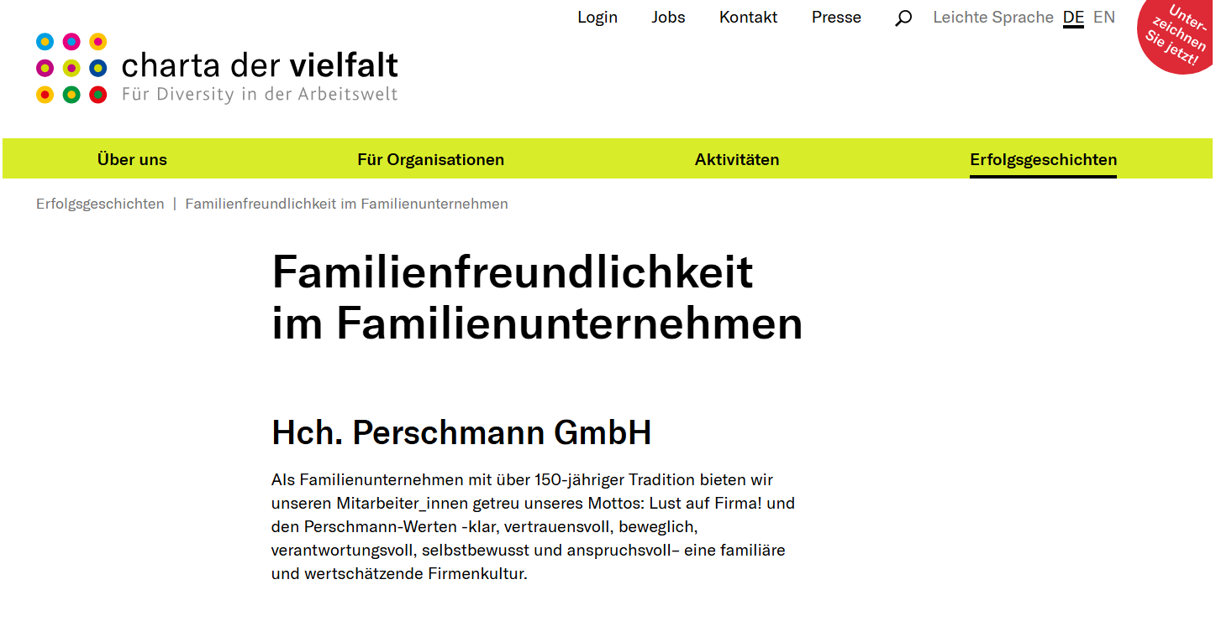
ImplementationPerschmann wants to make it easier for its employees to reconcile their professional and private lives and is committed to a good work-life balance. By taking a comprehensive strategic approach, flexible and individually tailored working hours are made possible, offering employees flexibility in the organisation of their working hours as well as the opportunity to work from home and a wide range of individual part-time models.
Perschmann is a signatory of the ‘Charta der Vielfalt’ (English: Diversity Charter) - a German business initiative with the aim of anchoring diversity in business and society. Find out more about Perschmann's approach here:
www.projectdare.eu
Follow our journey
This resource is licensed under CC BY 4.0

