Slide 1
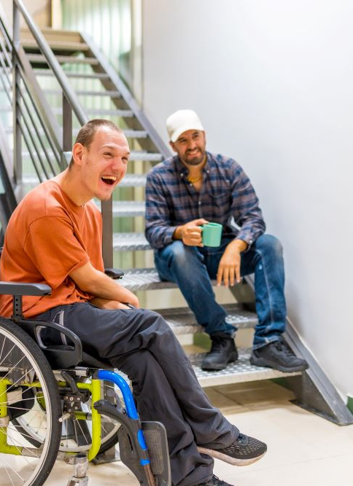




CASE STUDY
AfB (Germany)
CEO
Daniel Büchle
AfB (Arbeit für Menschen mit Behinderung) is a German social enterprise in the IT asset refurbishment industry. Headquartered in Ettlingen, Germany, AfB has grown over 20 years from a 4-person project into Europe’s largest non-profit IT company, now with 660 employees across 20 locations. Its mission pairs environmental sustainability (through refurbishing used electronics) with a powerful D&I focus: integrating people with disabilities into the workforce. As an officially recognized “Inklusionsunternehmen” (inclusive enterprise), AfB is legally and ethically committed to filling at least 40% of its jobs with people with disabilities. In practice, it far exceeds that target – currently 48% of employees have disabilities ranging from physical impairments (e.g. visual or hearing impairment, mobility limitations) to intellectual and learning disabilities. AfB’s core ethos is summed up by its CEO: “At our company, people with and without disabilities work together in virtually every department… We always focus on people’s potentials, not their deficits.”
Company Name
AfB
www.projectdare.eu
This resource is licensed under CC BY 4.0

Slide 2
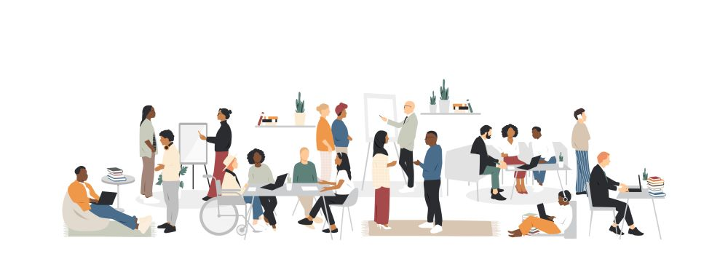
D&I Initiatives Implemented
This fosters mutual understanding and eliminates stigma, as all staff collaborate as equals. AfB’s inclusive culture is reinforced through company values of respect and teamwork; managers lead by example to ensure everyone is treated with equal respect. The result is a daily work environment where diversity is normalized – “Menschen mit und ohne Behinderung arbeiten zusammen” (“people with and without disabilities work together”) is the standard at AfB.
Tailored Onboarding and Training: AfB recognizes that some employees with disabilities may need additional support to thrive. The company provides personalized onboarding programs depending on a person’s prior education or experience​. New hires with disabilities might receive one-on-one training, mentoring, or adjusted training schedules to learn the job at their own pace. AfB also runs special workshops to build the skills and independence of employees with disabilities​(for example, training in using assistive technologies or soft skills coaching), which increases their autonomy and confidence at work. This investment in employee development helps ensure that disabled staff can advance in their careers. By empowering these team members, AfB improves retention and helps employees reach their full potential.
Benefits to the Company and Employees: AfB’s multifaceted D&I strategy has delivered significant benefits for both the business and its employees:
By focusing on abilities over disabilities, AfB unlocks a vast talent pool that is often overlooked. In Germany, only about one-third of people with severe disabilities have a job despite many being highly qualified. AfB’s inclusive model turns this untapped potential into a competitive advantage. The company has been able to hire dedicated, skilled workers who might otherwise face barriers to employment – gaining loyal employees in roles that are historically hard to fill. This has been crucial in an industry that requires meticulous, quality-focused work (IT refurbishing) and during times of skilled labor shortage.
Inclusive Hiring and Quota Commitment: AfB’s hiring strategy actively seeks out candidates with disabilities. The company works closely with public employment agencies and disability organizations to recruit people with various impairments. It has a formal policy that 40% of its workforce must be people with disabilities​, ensuring sustained focus on inclusive recruitment. This policy is embedded in AfB’s corporate objectives and is central to its identity as a social business.
Barrier-Free Workplace & Adapted Job Design: AfB creates barrier-free jobs by adapting roles and workplaces to fit employees’ abilities. Every step of its IT refurbishing process – from collecting used devices, through data wiping and repairs, to reselling – is designed to be accessible and inclusive to employees with different needs​. For example, facilities are wheelchair-accessible and machinery or workflows can be modified for those with sensory or cognitive disabilities. AfB also employs “disability managers” who ensure any needed workplace accommodations are provided. This approach means disabled employees can perform meaningful work without hindrance, and no position is off-limits due to a disability.
Side-by-Side Team Integration: Rather than segregating staff, AfB mixes disabled and non-disabled employees together on teams at all levels​. Whether in logistics, tech repair, sales, or administration, colleagues work hand-in-hand.

Slide 3



We acknowledge our responsibility to consider the economic, social and environmental impact of our business decisions and actions.
www.projectdare.eu
Follow our journey
This resource is licensed under CC BY 4.0

