Slide 1

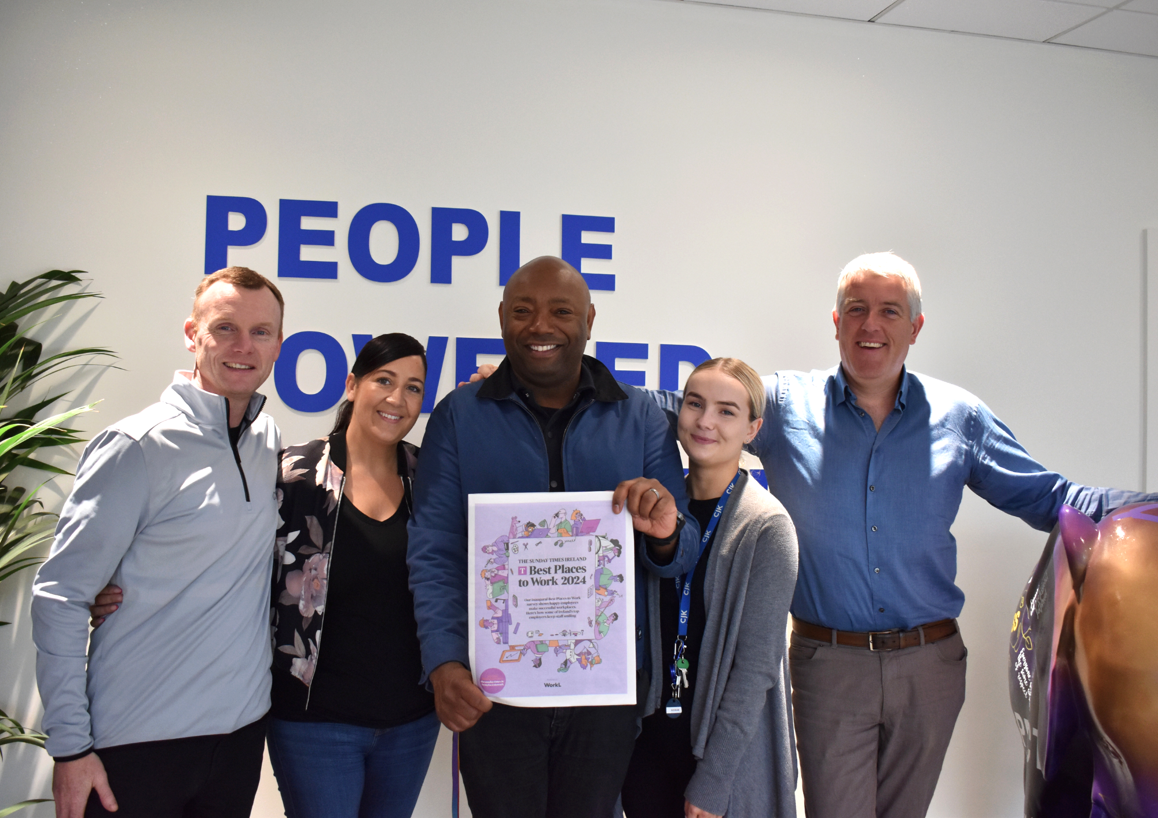
CASE STUDY
CJK Engineering, Ireland
Company Name, Country
CJK Engineering, Ireland
Industry, Number of Employees
Mechanical and Electrical Services, 220 Employees
CJK is an Irish-owned mechanical and electrical services contractor with over 25 years’ experience in providing top-quality services to clients in the industrial, pharmaceutical, public, and commercial sectors. Their unwavering commitment to quality is reflected in their highly skilled and motivated team, innovative solutions, and dedication to sustainability.
The CJK culture of respect and inclusivity not only enhances the quality of their work but also fosters a sense of community and camaraderie amongst its’ staff, creating a highly motivated team that is committed to delivering exceptional services to their clients.
D&I Strategy
Recruitment & Retention Strategies
Module Topic
Module 3
Removing Bias from Recruitment Process
Website
https://cjkengineering.ie
www.projectdare.eu

Slide 2
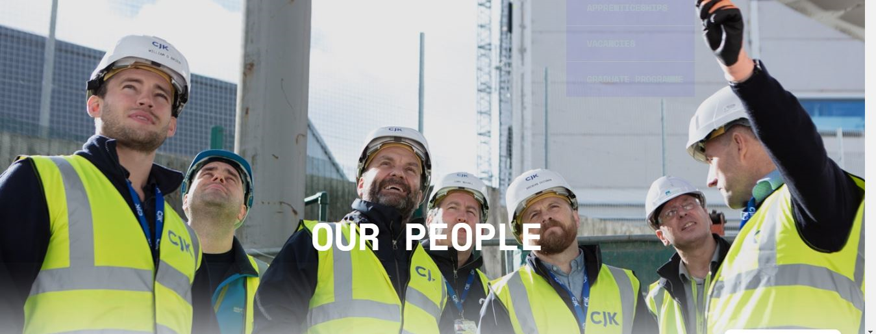
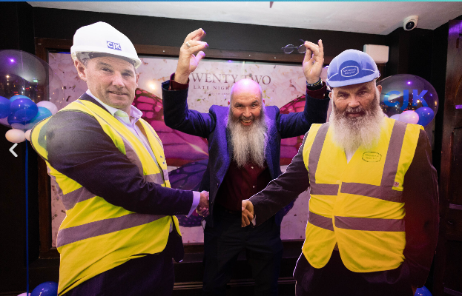
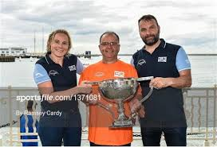
ENGINEERS, PROBLEM
SOLVERS, PARTNERS
“We are a people-first business that never loses sight of the importance in prioritising our employees and client relationships in everything that we do”
CJK Engineering emphasizes a strong commitment to diversity and inclusion, underpinned by a culture that values respect, openness, and teamwork. Their Human Resource leadership program is centred on continuous learning, supporting employees in their professional growth while fostering an inclusive environment. CJK prioritizes the well-being and development of its team members, offering opportunities for growth and career progression. Their approach is people-first, ensuring that all employees are given the chance to reach their full potential.
Their HR leadership program focuses on sustained learning, education and professional development programs, ensuring that all employees have opportunities for progression. The company’s strategy is focused around creating an environment where every team member feels valued and supported to progress and excel in their respective roles and beyond the world of work reaping the benefits of cooperation with commitment across the company.
For more details, you can visit their About Us page.

Slide 3
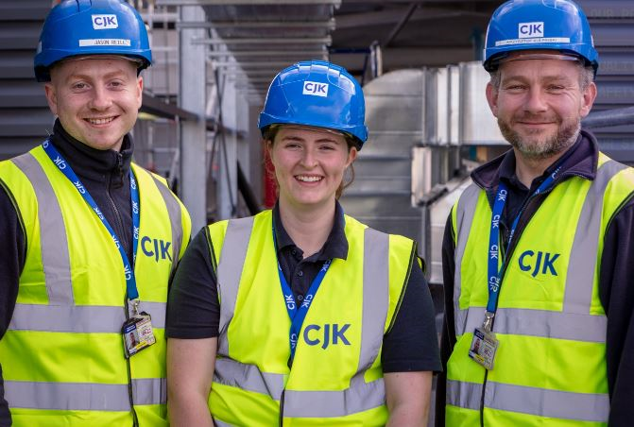
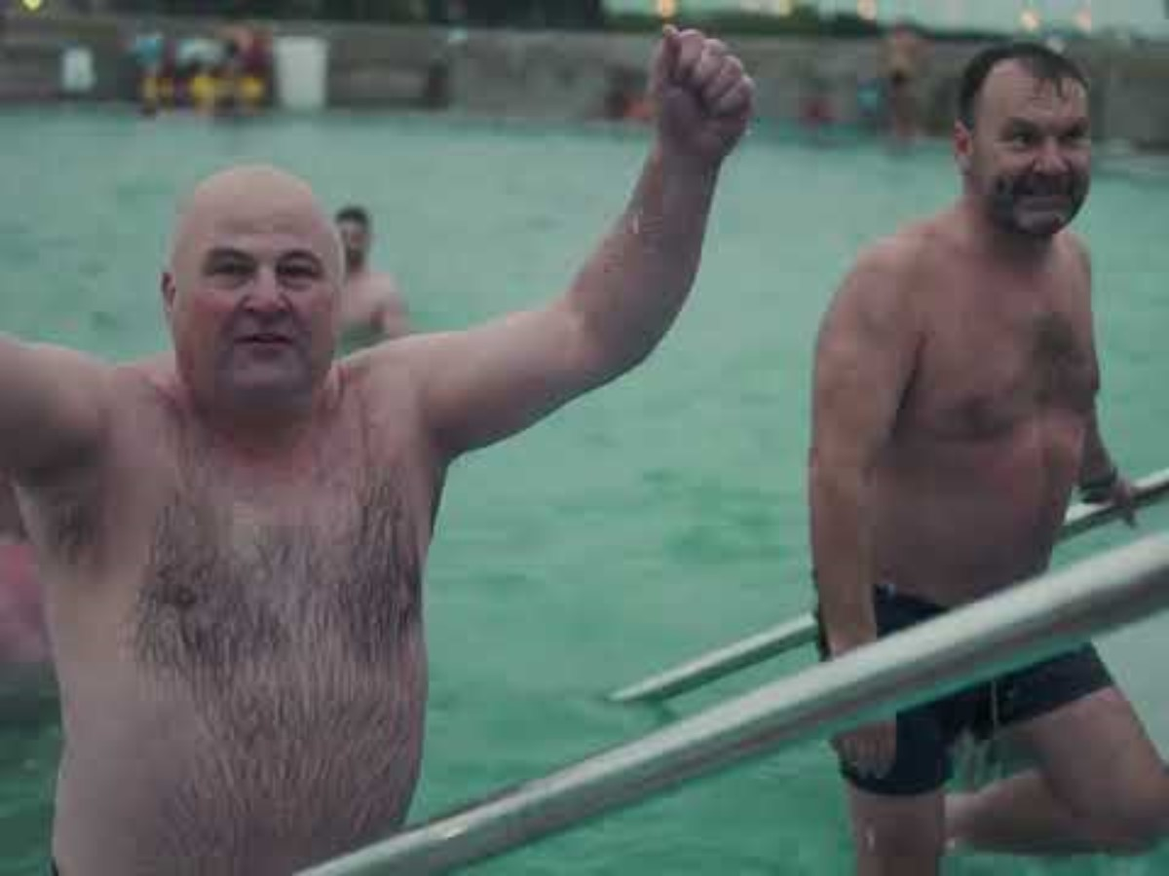
Why is it Important for SME Businesses to Invest in D&I?
CJK Engineering emphasizes the importance of diversity and inclusion (D&I) in fostering innovation, employee satisfaction, and business success. Their strategy focuses on creating a respectful and open culture where every team member can thrive. By investing in D&I, especially in small and medium-sized enterprises (SMEs), businesses can attract a wider talent pool, improve decision-making, and enhance their reputation. CJK’s Human Resource programmes supports this by prioritising continuous learning and growth opportunities for all employees, reinforcing their commitment to an inclusive workplace.
How has Implementing D&I Benefited the Company and its Employees?
CJK Engineering’s implementation of diversity and inclusion (D&I) has led to numerous benefits for both the company and its employees. By fostering a culture of respect and openness, they have seen improved teamwork and collaboration. The inclusive environment has attracted a broader talent pool, enhancing innovation and decision-making. Moreover, employees feel more valued and supported, leading to increased job satisfaction and retention. This strategic focus on D&I has strengthened CJK’s overall business performance and reputation.
Our Culture
At CJK, our strongest and most compelling belief is in the value of our people. We believe that each and every employee is critically important to the success of our company and must be given the opportunity and environment in which to reach their full potential.
Our commitment to our employees and their dedication to our clients form the basis and the priorities upon which we develop our entire organisation. This is the foundation of our corporate culture. These fundamental elements are reflected in a strong set of beliefs that collectively distinguish from our competition.

Slide 4
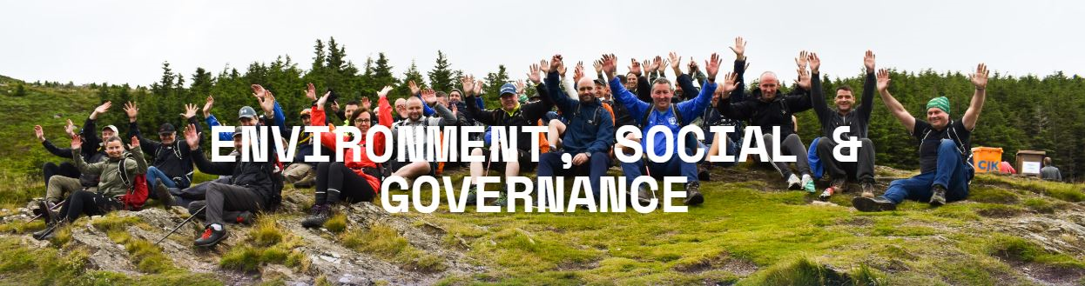
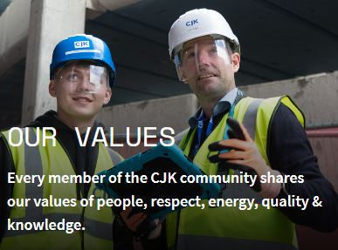
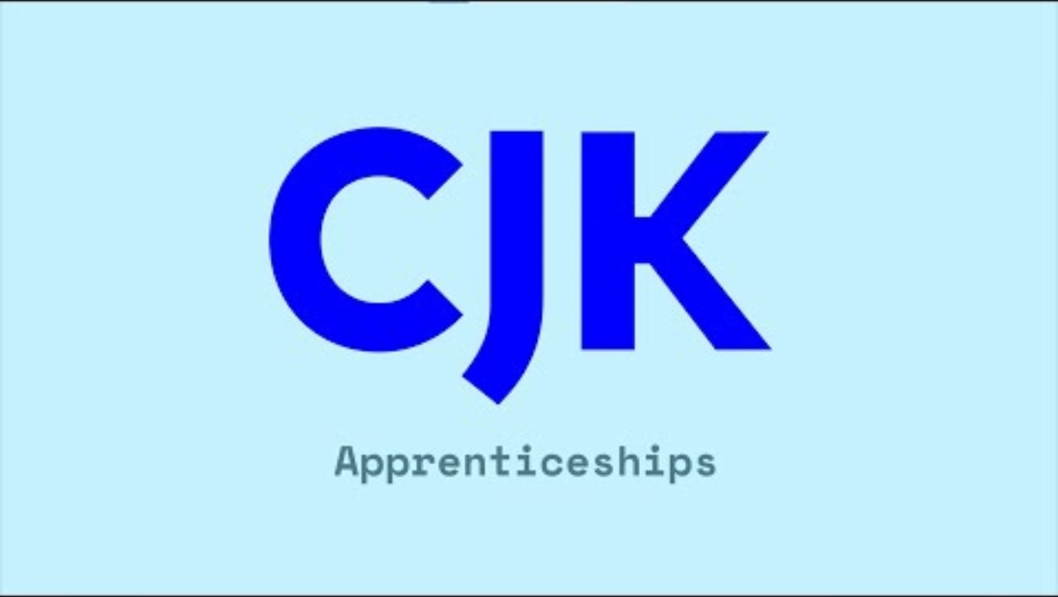
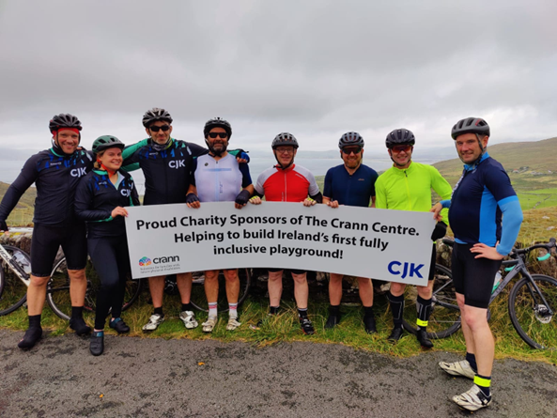
WE VALUE PEOPLE
“Team members are at the heart of CJK.
They are our community. We value each and every member, and work hard to provide support, flexibility and a work-life balance. We reward people’s efforts and provide opportunities for growth and career progression”
https://cjkengineering.ie/about-us/
What Were the Main Challenges and How Did You Overcome Them?
CJK Engineering faced challenges in implementing diversity and inclusion (D&I), particularly in shifting mindsets and integrating D&I into daily practices. To overcome these obstacles, they focused on continuous education, open communication, and strong leadership support. By embedding D&I into their core values and ensuring that all team members understood its importance, they gradually built an inclusive culture. Leadership especially through people development played a critical role in driving these changes, making sure that D&I was not just a policy but a lived experience for all employees.
What is the Plan for the D&I Strategy for the Future?
CJK Engineering’s future strategy for diversity and inclusion (D&I) focuses on further embedding D&I principles into their organizational culture. They plan to enhance training programs, ensure continuous learning, and create more opportunities for underrepresented groups.
Additionally, they aim to refine their recruitment processes to attract a more diverse talent pool and continue to promote an inclusive environment where all employees feel valued and supported.
For more detailed information, visit CJK Engineering.

Slide 5
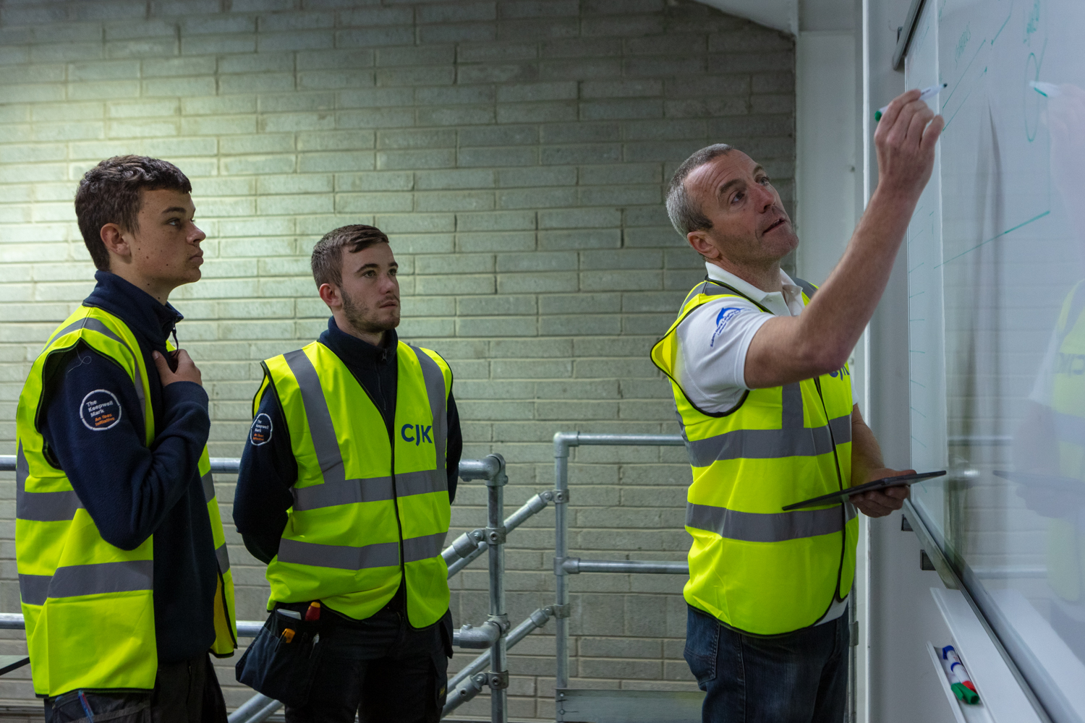

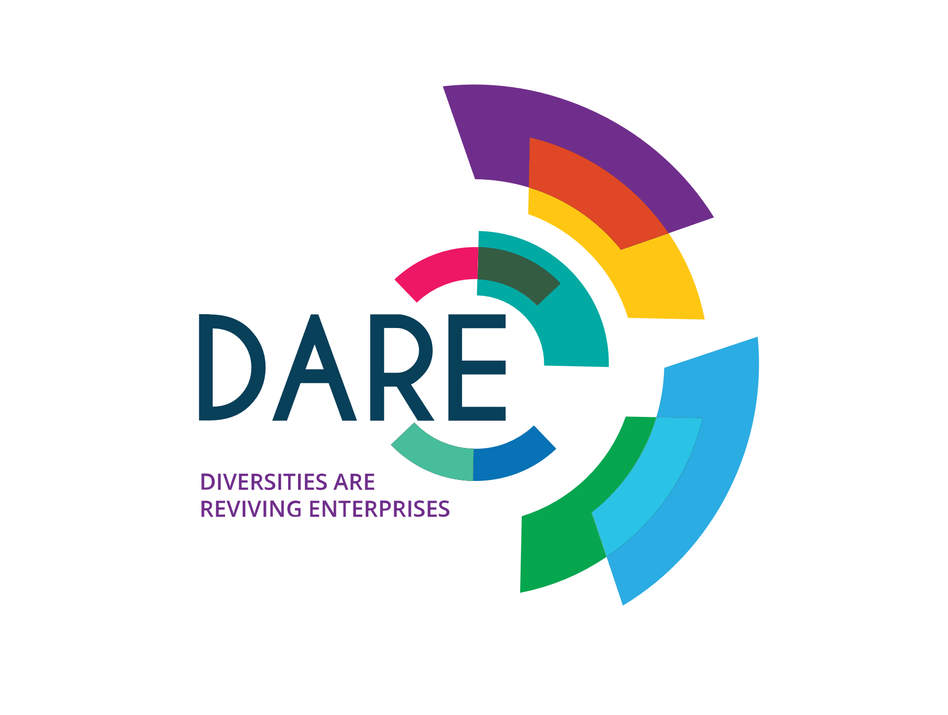
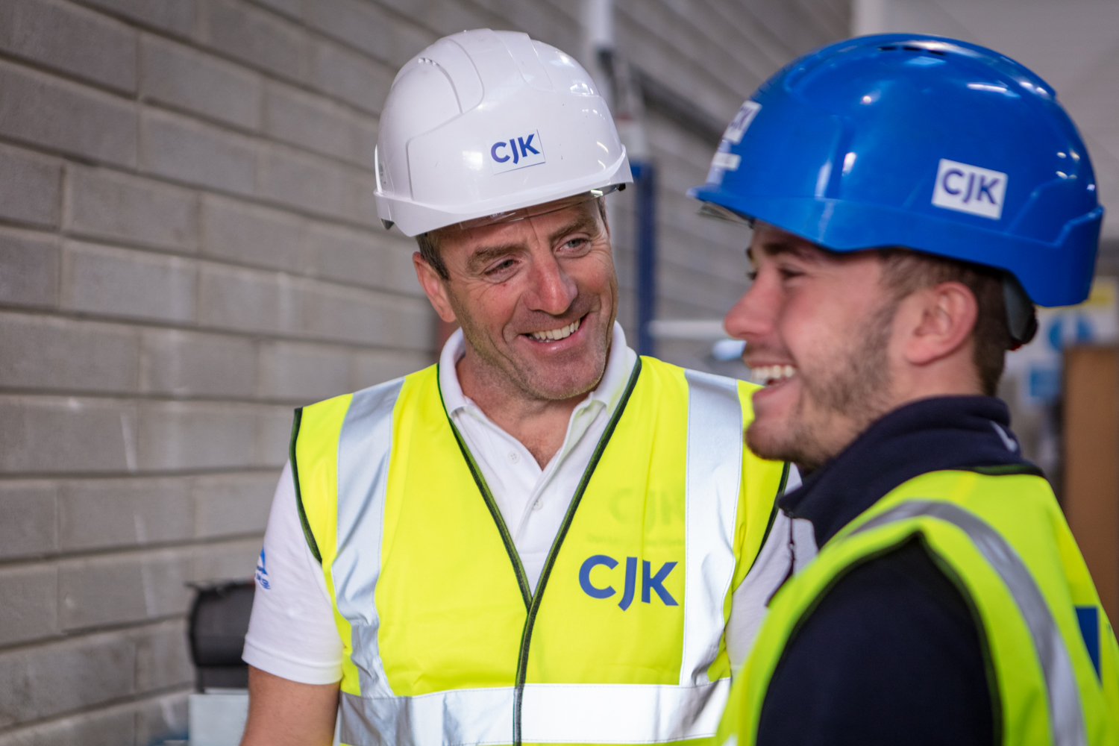




TRAINING & DEVELOPMENT CENTRE
We are firm believers in education and the need to continually update our skills and knowledge. Our people are the foundation for our continued growth, and our investment in continuous professional development has produced an innovative and passionate team that deliver projects safely, efficiently and to the highest industry standards.
We are dedicated to helping our apprentices discover and develop their skills and talent. At CJK, you will be working with some of the best people in the industry, gaining the knowledge and experience to give your career a kickstart. Many of our apprentices stay on with us once they have graduated; we then help them advance their careers through our in-house Training Academy.
To give you an idea of the possibilities,
Virtually all of the management team at
CJK started out as electrical apprentices.
We also have former apprentices currently
working in our commercial, engineering and
management teams.
https://cjkengineering.ie/careers/apprenticeships/
www.projectdare.eu
Follow our journey
This resource is licensed under CC BY 4.0

