Slide 1





CASE STUDY
3DSE (Germany)
CEO
Dr. Stefan Wenzel
3DSE is a Munich-based engineering and R&D consulting SME with around 50 employees and offices in Munich, Vienna, and Chicago​. Traditionally, like many technical consultancies, its workforce was predominantly German and male. Around 2018-2019, in response to client expectations (especially in the international aerospace sector) and talent shortages, 3DSE made diversity and inclusion (D&I) a strategic priority​. In 2019 the company formally embedded D&I as a “central lever of strategic importance” in its corporate strategy and leadership principles​, and by 2022 it underscored this commitment by signing the German Diversity Charter (Charta der Vielfalt)
Company Name
3DSE
www.projectdare.eu
This resource is licensed under CC BY 4.0

Slide 2

D&I Initiatives Implemented
Job descriptions were reviewed to eliminate bias, and hiring managers received training to recognize unconscious bias (in line with 3DSE’s charter commitments). While specific metrics aren’t public, the change is evident: in a few years, 3DSE’s team composition became significantly more diverse in terms of gender and nationality. The firm also supports continuous learning and development for all employees, ensuring equal opportunities for advancement so that diverse talent can grow within the company.
Benefits to the Company and Employees: 3DSE’s D&I strategy has yielded tangible benefits. Internally, a more inclusive culture has improved employee engagement and retention, as people feel their unique perspectives are valued. Feedback from staff confirms a stronger sense of belonging and better teamwork now that the company is more diverse. Different viewpoints have spurred greater creativity and problem-solving, important for an innovation-focused business. Externally, 3DSE’s diversity makes it more competitive in a global market: teams that mirror the international nature of clients (e.g. in aerospace) can better understand client needs and drive innovation. In addition, embracing diversity has enhanced 3DSE’s employer brand. In a tight labor market, “Vielfalt zieht Vielfalt an” (“diversity attracts diversity”) – diverse teams have a magnetic pull on job seekers. By being known as an inclusive employer, 3DSE can attract a broader talent pool and mitigate skills shortages. Overall, the company’s investment in D&I has strengthened its innovation capability and reputation, while employees enjoy a more open, equitable workplace.
Top-Management Commitment: Leadership actively championed D&I from the outset. D&I goals were integrated into 3DSE’s strategy and leadership guidelines to ensure management accountability​. Executive buy-in was seen as critical: “Am wichtigsten ist es, von Anfang an die Führungsebene mitzunehmen” (German for “Most important is to get the leadership on board from the start”)​, as the HR manager driving D&I noted. This set a tone of inclusive leadership at the top.
Inclusive Workplace Culture: 3DSE worked to cultivate an open and tolerant culture. The firm initiated employee training, discussions, and feedback rounds on diversity to raise awareness and gather ideas​. These regular workshops and surveys encouraged staff to voice concerns and suggestions, helping employees feel heard and involved in the inclusion journey. Over time, team feedback indicated the workforce had become “much more heterogeneous” and that different opinions and perspectives were more appreciated in daily work – a clear sign of growing inclusion.
Diverse Talent Recruitment & Development: The company began broadening its hiring practices to attract talent from underrepresented groups (e.g. international candidates and women) in its technical field.

Slide 3

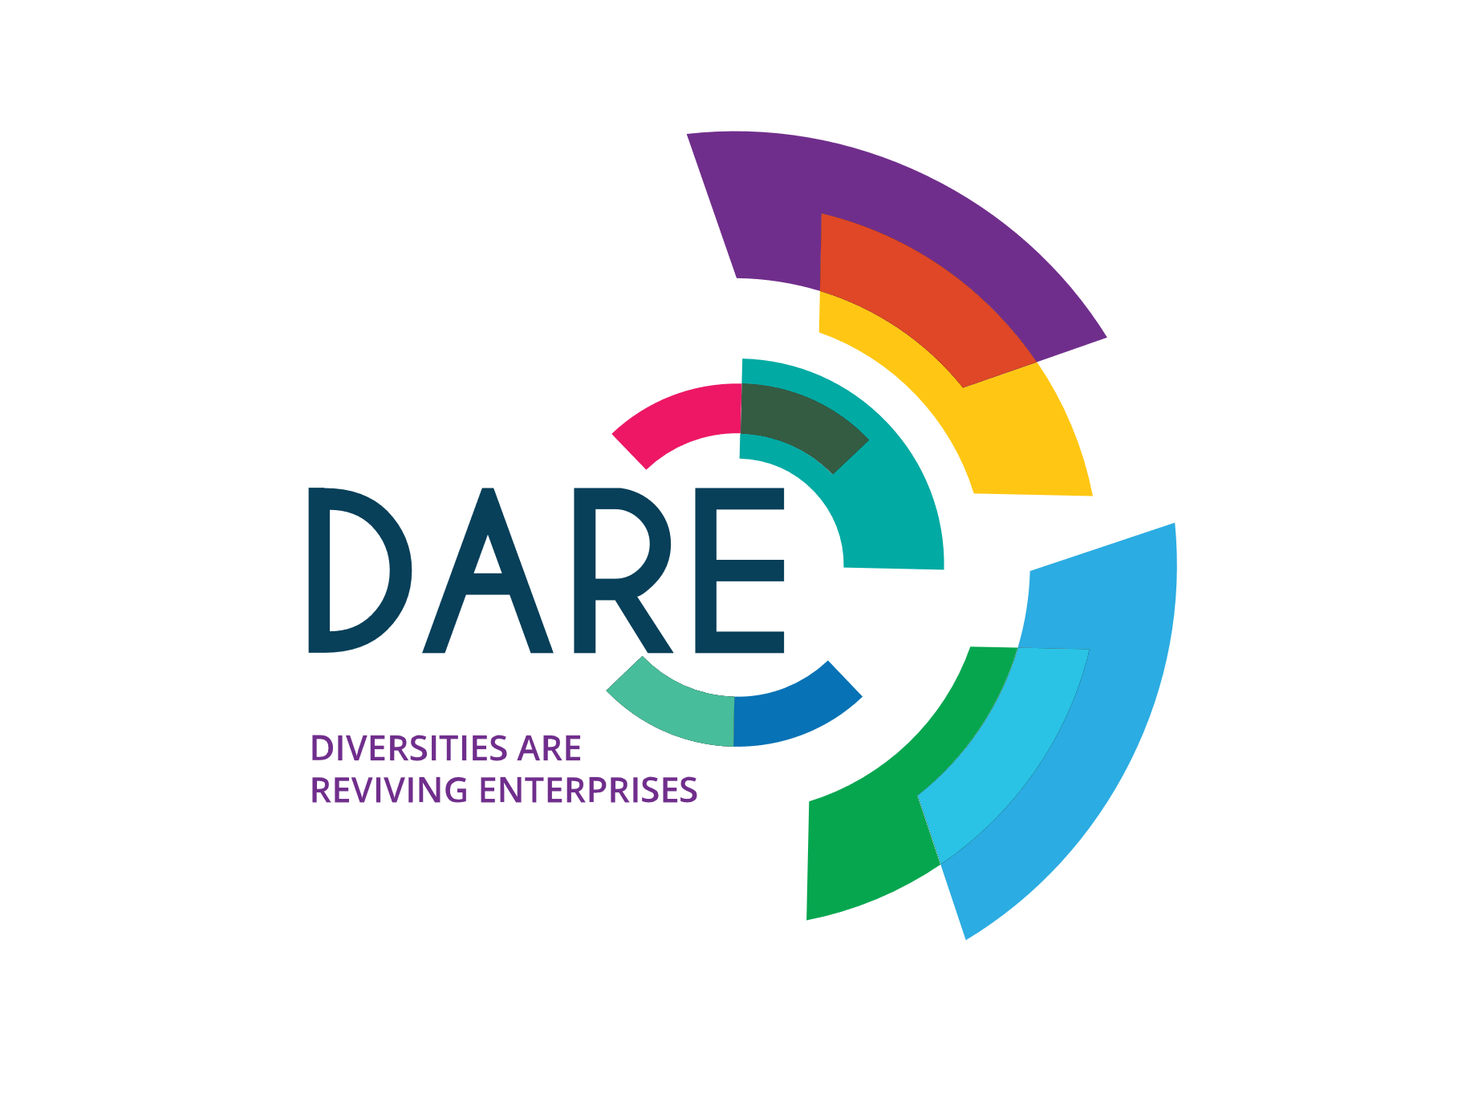
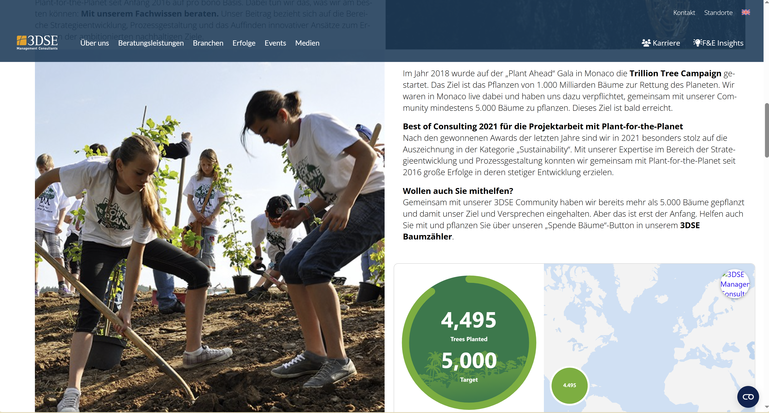

„Diversity attracts Diversity“
www.projectdare.eu
Follow our journey
This resource is licensed under CC BY 4.0

