Slide 1
CASE STUDY
Wyborowa Pernod Ricard
Company Name, Country
Wyborowa Pernod Ricard
Industry, Number of Employees
They are part of Pernod Ricard group - a global producer and distributor of spirits and wines worldwide. They have one of the broadest brand portfolios on the market, composed to respond to the needs of consumers who are at the center of their attention. Convivialité is the heart of everything we do, from our vineyards and farms to distilleries, production sites, retail outlets and offices around the world.
As the claim, they are committed to offering products and experiences which surprise and delight, and to ensure a respectful, diverse and sustainable future filled with positive human connections for all.
Manufacturer and distributor of spirits and wines 400 employees (2022)
D&I Strategy
Module Topic
Module
Website
https://www.pernod-ricard.com/pl/locations/poland
www.projectdare.eu

Slide 2
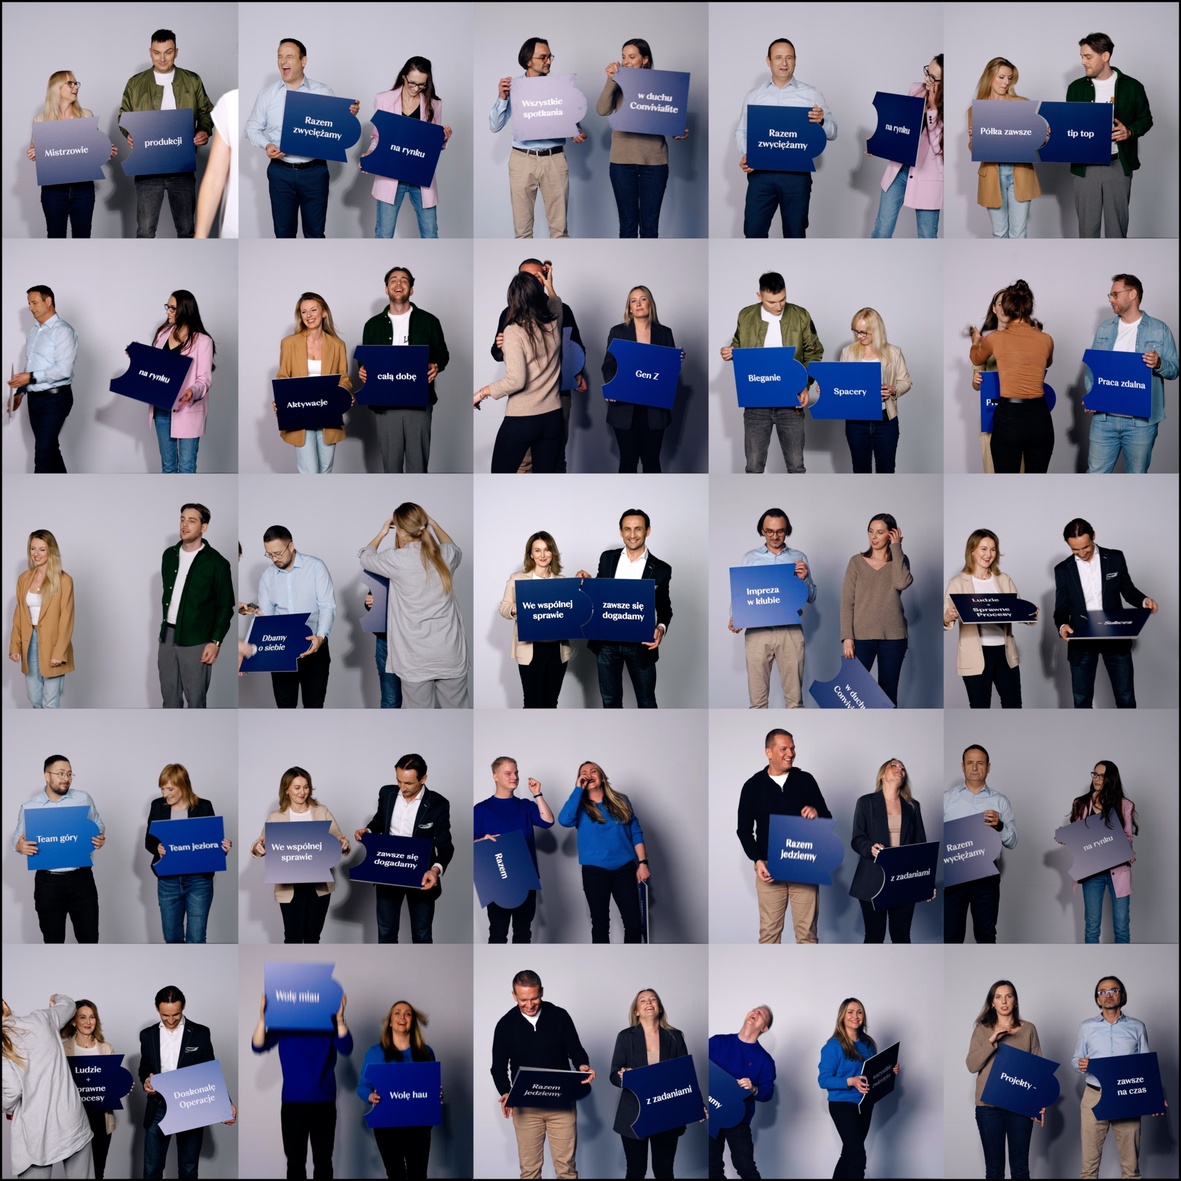
„The differences inspire us!”
The campaign, which has been launched, is one of the elements of the process of strengthening and developing the D&I area at Wyborowa Pernod Ricard. In it we meet duos of people - employees of the company, who represent diverse tastes, have different routines and needs, belong to different age groups, but what unites them is the ability to understand and cooperate with each other. The campaign is being implemented in social media - on Instagram and Facebook #wyborowa_kariera. In addition, a team of D&I Champions has been created from among willing employees of the company, consisting of people who work every day in different locations. Its task is to work on even better understanding and management of diversity in the organization, precisely defining the local needs of employees, which will translate into recommendations of specific actions that can meet them. The campaign “The differences inspire us!” shows that it is important for us to be ourselves, be authentic, be open to others, respect differences and be inspired by diversity. Along with other activities in the area of diversity and inclusiveness, the campaign is part of building a workplace where everyone feels comfortable, has a chance to realize themselves professionally and grow.
Wyborowa Pernod Ricard conducts regular educational activities to increase employees' knowledge and awareness in the area of diversity and inclusiveness (D&I). In early October, the company launched the “The differences inspire us!” campaign with employees. Its goal is to promote company values and foster diversity, as well as strengthen and support diverse teams. The campaign is aimed at both current employees and candidates from outside the organization.
Source:https://hrstandard.pl/2024/11/27/nas-roznice-inspiruja-wyborowa-pernod-ricard-wspiera-zroznicowanie-swoich-pracownikow-i-rusza-z-nowa-kampania/

Slide 3
Why is it Important for SME Businesses to Invest in D&I?
There are many studies showing that diverse teams are more creative, effective and open-minded than homogeneous teams - which is mainly due to the diverse experiences of individual members of such teams. In turn, companies that support diversity and inclusiveness are successful in the market and often record better results than companies that do not pay much attention to this aspect. The research shows that that majority of companies inluding SME’s have a diversity management strategy in place, but only 15% of employers actually have programs in practice to support some group of employees.
Meanwhile, employees today are no longer just looking for a well-paid job, but also a place where they will feel like themselves, where they will be judged for their competence, accepted and appreciated regardless of their gender, age, background, views or orientation, and where they can grow. These are the values that guide Wyborowa Pernod Ricard, which wants to build a culture of diversity and inclusiveness. The campaign now being launched supports these efforts
How has Implementing D&I Benefited Your Company and Employees?
Wyborowa Pernod Ricard has identified the benefits of diversity and has consistently promoted an inclusive work culture, implementing initiatives and proactive measures for diversity and inclusivity, including, among other things, increasing the role of women and their presence in top positions.
The company regularly conducts educational activities to increase employees' knowledge and awareness of D&I. These include mandatory training sessions for managers on building diverse teams. Topics covered include inclusive language and behavior, unconscious biases, and the ability to recognize and sensitize employees to potentially discriminatory actions - so they can avoid them. In addition, Wyborowa Pernod Ricard has included an “Inclusion Index” in its annual employee satisfaction survey, developed globally by the Pernod Ricard Group. Employees can also use the inclusion self-assessment tool. With these tools, the company can continuously monitor its internal diversity culture constantly increasing its business potential.
Source: https://www.cdprojektred.com/pl/diversity

