Slide 1
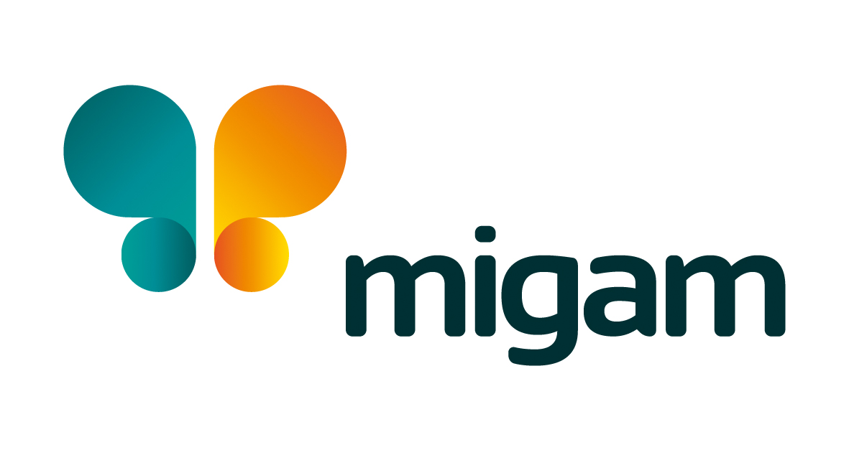
CASE STUDY
Migam
Migam.org is a technology company specializing in creating communication solutions for Deaf people. Their main product is a sign language interpreting system that enables Deaf people to access services and information more easily. Migam is a positive impact company (Social Impact) for the Deaf community. Among their clients there are companies and institutions and members of the Deaf community. Since the establishment of Migam, the members of the team have interpreted around 300,000 calls (via video connection system) and translated over 5,000 videos and documents. The Deaf people are co-founders and co-creators of Migam. The team also consists of sign language experts, and CODA (Children of Deaf Adults.
Company Name, Country
Migam/ Poland
Industry, Number of Employees
Creation of communication solutions, Barierrs - free Work Agency
D&I Strategy
Module Topic
Module
Website
https://migam.org/
www.projectdare.eu

Slide 2

4. Educational webinars
Hosts free weekly webinars on accessibility, serving Deaf people, and new obligations for public entities on accessibility.
AWARDS
The company was recognized in the Polish Diversity Awards 2023 for its positive impact on the Deaf community. Their customers are companies and institutions, and their target group is Deaf people. Their flagship product is the Migam.org interpreter. Since its inception, they have translated about 300,000 conversations through the video call system, as well as more than 5,000 videos and documents.
COLLABORATION WITH OTHER COMPANIES
Migam.org works with various companies and institutions to support them in the area of accessibility and inclusion. For example, McDonald's was the first company in the industry to start working with Migam.org, an organization that supports contact with Deaf people at the recruitment stage. The company has also developed the Staffing HUB, a knowledge base with educational materials on also conducting inclusive, non-discriminatory recruitment
SUMMARY
Migam.org is an example of a company that, despite a small staff, implements effective diversity and inclusion practices. Their efforts include hiring Deaf people, operating an employment agency for people with disabilities, offering accessibility training and audits, and working with other companies to promote inclusivity.
Diversity and Inclusion Activities
Employment of Deaf People:
Migam.org actively employs Deaf people, including sign language experts and hearing children of Deaf parents, which contributes to an inclusive work environment.
2. Work Without Barriers Agency: Another mission is running the Work Without Barriers Agency, which specializes in recruiting people with disabilities. It offers training on openness and inclusion, economic and social aspects of labour activation for people with disabilities, new technologies for accessibility, and creating accessible documents.
3. Training and audits:
The company offers training on openness and inclusion, architectural audits and communication and information audits, as well as certification of the accessibility of entities in accordance with the Law of July 19, 2019 on Ensuring Accessibility for Persons with Special Needs.
webinar.migam.org+1LinkedIn+1Translated with DeepL.com (free version)
Source: https://migam.org/

