Slide 1

April 2025
Newsletter 4
By
TVW GmbH
Newsletter 4
DARE
https://projectdare.eu/

Slide 2
01
Welcome to Newsletter 4
02
The DARE Assessment at a Glance
03
contents
Benefits of the Assessment for SMEs

Slide 3


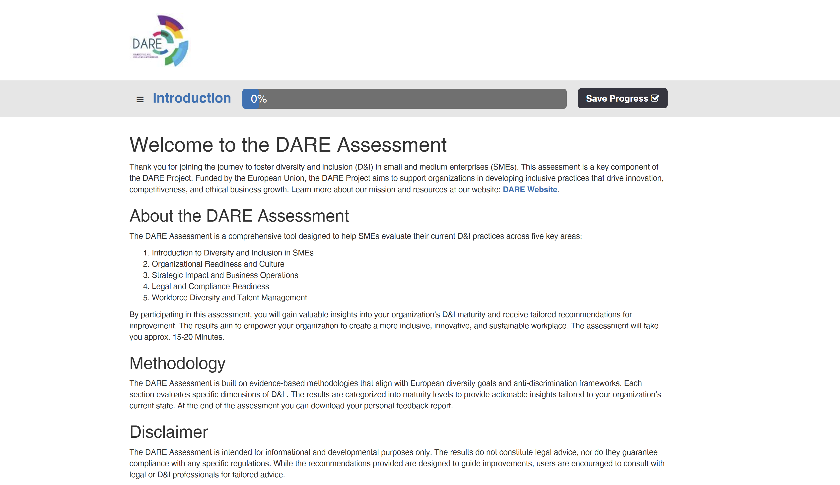
Welcome to Newsletter 4
Welcome to the fourth edition of the DARE Project Newsletter! As our initiative continues to grow, we are proud to share the progress we’ve made toward supporting small and medium-sized enterprises (SMEs) in building more diverse, inclusive, and resilient organizations. The DARE Project, co-funded by the European Union, is driven by a clear mission: to equip SMEs and vocational education and training (VET) providers with the tools, knowledge, and confidence to put diversity and inclusion (D&I) into practice.
This edition focuses on one of our most important milestones to date – the launch of the DARE Assessment Tool, a digital self-assessment that enables SMEs to evaluate their current D&I practices and identify meaningful next steps. Developed through extensive fieldwork, expert consultation, and pilot testing across multiple countries, the assessment is more than a diagnostic tool. It is a gateway to awareness, learning, and transformation.
We believe that fostering inclusive workplaces is not only a social imperative but also a strategic advantage in today’s competitive landscape. With labour markets becoming increasingly diverse and the demand for ethical, transparent, and inclusive business growing, SMEs that understand and integrate D&I into their operations are better positioned to thrive.
This newsletter introduces the key features of the DARE Assessment Tool and explains how it can benefit SMEs across sectors. We invite you to explore the tool, share it with colleagues, and join us in advancing inclusive business practices across Europe. Thank you for being part of the DARE community!
Your Shortcut to the Assessment – just press on the Screenshot below

Slide 4
The DARE Assessment at a Glance
The DARE Diversity & Inclusion Readiness Assessment Tool is a practical, easy-to-use digital instrument designed specifically for small and medium-sized enterprises (SMEs). Its purpose is to help businesses assess where they stand in terms of diversity and inclusion – and to provide clear, personalized guidance on how they can improve.The tool is structured around five key areas:
Introduction to Diversity and Inclusion in SMEs
Organizational Readiness and Culture
Strategic Impact and Business Operations
Legal and Compliance Readiness
Workforce Diversity and Talent Management
Each section includes a set of carefully formulated questions that explore different dimensions of D&I in the workplace. Users respond by selecting the answers that best reflect their current situation. Once the assessment is completed, the system generates a Personalized Feedback Report. This report includes a summary of responses, an evaluation of the organization’s maturity level in each area, and tailored recommendations to guide practical improvements.
Built on research and best practices, the tool is fully accessible via desktop, tablet, and mobile. It is also available in three languages: English, German, and Polish – making it useful for SMEs across Europe.
What sets the DARE Assessment apart is its dual function:
For SMEs, it provides a self-directed reflection process with professional-grade guidance.
For VET educators and trainers, it offers a structured way to teach D&I topics, grounded in real-world organizational practice.
Whether used by business owners, HR professionals, team leaders, or VET instructors, the DARE Assessment is an engaging and insightful entry point into the world of inclusive organizational development.

Slide 5
Benefits of the Assessment for SMEs
For small and medium-sized enterprises, managing diversity and inclusion can be challenging. Unlike large corporations with dedicated HR teams or consultants, SMEs often lack the time, resources, or expertise to approach D&I in a structured way. This is where the DARE Assessment makes a real difference – by providing a simple yet powerful framework that translates complex concepts into clear, manageable steps.
Here are some of the most important benefits for SMEs using the DARE Assessment Tool:
Clarity and Self-Reflection: The tool encourages honest reflection on organizational practices. It helps SMEs uncover gaps, challenge assumptions, and clarify their current position in the D&I journey. Even businesses with no prior D&I experience can use the tool as a starting point for learning and development.
Practical, Action-Oriented Feedback: Every organization receives a tailored report, complete with concrete recommendations and suggested actions. These range from small steps – such as reviewing job postings or organizing a team discussion – to more strategic initiatives like creating inclusive leadership development programs or formalizing anti-discrimination policies.
Strategic Alignment: D&I is more than a human resources topic – it affects innovation, customer relations, legal compliance, and brand reputation. The assessment helps SMEs understand how diversity and inclusion contribute to their broader business objectives and long-term resilience.
Cost-Effective Support: Because the tool is available online and free to use, it offers excellent value for SMEs with limited budgets. It provides expert-level guidance without the need for external consultants, while also linking users to free educational resources from the DARE Knowledge Hub.
Enhanced Employee Engagement: Inclusive workplaces are more attractive to diverse talent and lead to greater employee satisfaction and retention. By involving staff in the assessment process or sharing the feedback report internally, SMEs can foster a culture of openness and collaboration.
Reputation and Market Advantage: More customers, partners, and funding institutions are looking at how companies approach social responsibility. By taking proactive steps to address diversity and inclusion, SMEs position themselves as forward-thinking, responsible, and competitive players in the market.

Slide 6






The European Partners working on the DARE project are
Roscommon LEADER Partnership (Ireland)
Momentum Marketing Services (Ireland)
Northern Chamber of Commerce (Poland)
The Vision Works (Germany)
European E-learning Institute (Denmark)
Partners Involved In The Project

