Slide 1
March 2025
Newsletter 3
By
MMS, Ireland
Newsletter 3
Launch of the DARE Training Course & Knowledge Hub
https://projectdare.eu/

Slide 4
Welcome To FREE Resources
DARE aims to tackle labour market shortages by promoting a more inclusive and diverse European Economy by enabling VET Professionals to train SMEs to be more diversity-oriented. SMEs will be able to develop and engage more with marginalised and discriminated groups and become part of a more inclusive ‘labour market’. Employability Enterprise, SMEs and entrepreneurship Inclusion. Promoting Equality and Non-discrimination
Free Assessment Tool, Case Studies, Training Course and Knowledge Exchange Hub
FREE Online Assessment (Access Today)
Aims to support small business owners in developing inclusive practices that drive innovation, competitiveness, and ethical business growth. Covers key business areas such as company readiness and culture, strategic impact on business operations, legal and compliance readiness, workplace development, and talent management. Gain valuable insights about your company's inclusivity by receiving a recommendations report at the end.
Start the Assessment here: https://thevisionworks.brilliantassessments.com?external=DARE_ASSESSMENT

Slide 5
FREE Training Course (Access Today)
The DARE online course is designed to empower Small and Medium-sized Enterprises (SMES) to embrace Diversity & Inclusion (D&I) as a strategic advantage, enhancing business operations and enabling progressive growth. Our course is built around six training modules that provide practical tools, strategies, and insights so SMES can nurture inclusive workplaces, attract diverse talent, and drive business success.
Designed for: European SMES, HR Professionals, and VET Educators, SME management and owners, VET educators, HR professionals, business leaders, team leaders, marketing teams and community coordinators.
Start your learning journey with our targeted 6 modules (22 parts); start with your priority area(s). The DARE Modules are interactive learning blocks designed to help SMES build diverse, equitable, and inclusive workplaces. Learn real-life practical knowledge, insights, exercises, and best practice case studies. At the end of this course, you will be able to unlock the power of how DEI can drive sustainability and innovation in your company.
Start your learning journey here: https://projectdare.eu/courses/learning-pathways/

Slide 7
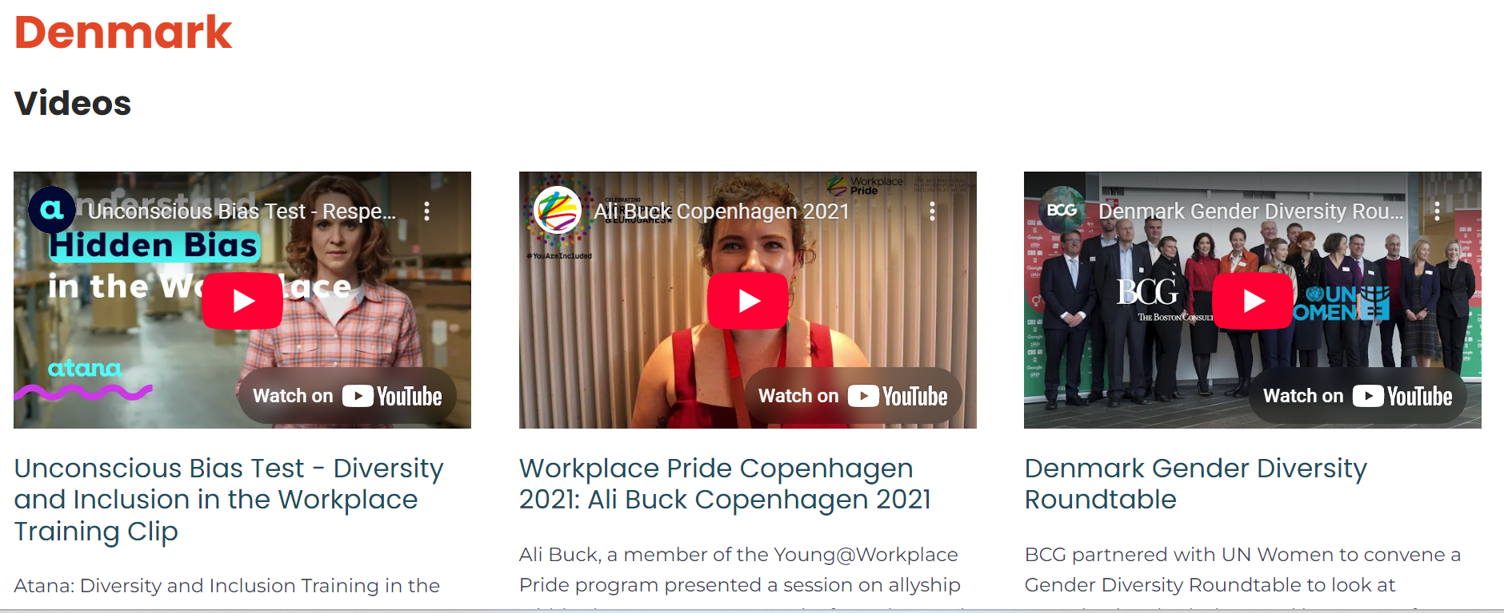
The Knowledge Hub (Access Today)
The DARE Knowledge Sharing Hub is your go-to platform for enhancing diversity and inclusion (D&I) practices within small and medium-sized enterprises (SMES) across Europe. Whether you're an SME owner, VET trainer, or an employee eager to foster a more inclusive workplace, this hub offers a wealth of resources tailored to your needs.
Who is the HUB for?
SME Owners and Managers who want to unlock the potential of a diverse workforce and lead their companies towards more inclusive practices. Vocational Education and Training (VET) Providers are looking to enrich their curriculum and support SMES in adopting cutting-edge D&I strategies. Employees and HR Professionals are eager to champion diversity and inclusion initiatives within their organisations.
1. Click to access the Hub here https://projectdare.eu/knowledge-sharing-hub/ 2. Explore the content (case studies, podcasts, videos, etc.) 3. Join our LinkedIn network https://tinyurl.com/mveb3deb

Slide 8
CONNECT with DARE
Website https://projectdare.eu/
Facebook https://www.facebook.com/profile.php?id=100092188720908
Linked In https://www.linkedin.com/company/94290387/admin/
Linked In Network https://tinyurl.com/mveb3deb
PRIMARY TARGET GROUPS
SMEs l Diversity. Equality and Inclusion Experts & Organisations in the Workplace l VET
#inclusivityanddiversity #smesofireland
#erasmusplus #DARE #equality #VET #humanresources
https://projectdare.eu/

