Slide 1

November2023
Newsletter 1
By
Roscommon LEADER Partnership
Newsletter 1
DARE
https://projectdare.eu/

Slide 2
01
WELCOME
02
The Need For DARE
03
The Project Results
contents
04
Target Audience
05
Kick Off Meeting

Slide 3


Welcome To Our Project
The DARE Project is an Erasmus+ VET project that’s working towards upskilling small to medium enterprises (SMEs) about the economic and ethical gains that diversity & inclusion bring to the workforce. DARE will help SMEs around Europe to overcome systemic and individual biases like age, race, ethnicity, gender, disability and sexual orientation.
Follow Us On Social Media to keep up to date with the project!
DARE Facebook
DARE LinkedIn

Slide 4


The Need For DARE
Europe is facing a serious labour shortage with 3% of all available jobs vacant, more than ever since statistical records of this data started in 2006.
By embracing the principles of diversity and inclusion and putting strategies in place, European SME’s can unlock previously “invisible” talent pools.
Diversities are Reviving Enterprises (DARE) is a transformative VET project which will develop a new suite of resources to sensitise and upskill European SMEs (and those who train them VET educators) about the economic and ethical gains diversity and inclusion bring to small business workforces.
Many countries, Ireland and Poland in particular, are slow to make gains when it comes to diversity and inclusion. SMEs still tend to see diversity as a challenge (financially, organisationally, culturally, etc.) while we can learn from Germany and Denmark who are somewhat ahead.
74% of participants in our DARE SME survey were unsure of the full range of benefits of having a diverse workforce They also indicated (89%) that do not currently have the support or upskilling opportunities to meet inclusion and participation.

Slide 5
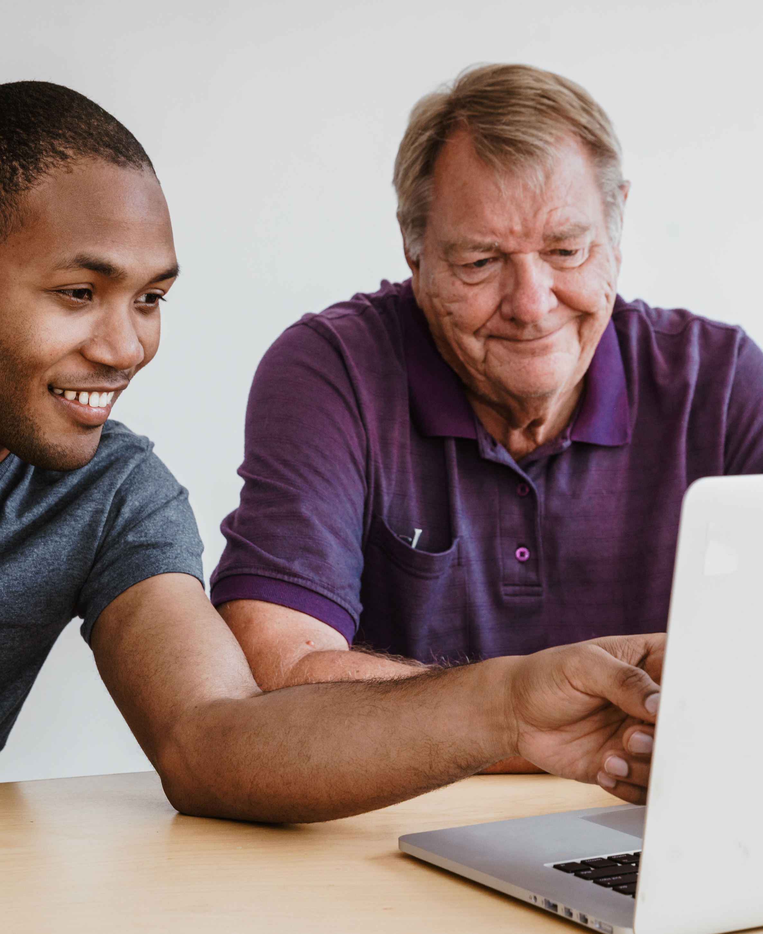
The strength of the team is each individual member. The strength of each member is the team
Phil Jackson

Slide 6






The European Partners working on the DARE project are
Roscommon LEADER Partnership (Ireland)
Momentum Marketing Services (Ireland)
Northern Chamber of Commerce (Poland)
The Vision Works (Germany)
European E-learning Institute (Denmark)
Partners Involved In The Project

Slide 7
Project Results
There are 3 main results to this project:
WP2: Competence Framework & Curriculum Development
This WP2 is broken down into 2 core parts, the first one being the frame work and the second part being the curriculum development, which will be based off the framework. This framework will consider the skills and knowledge needed by SMEs to meet the challenges of transformation regarding diversity and inclusion.
The Curriculum is the utilization of the framework and it will define concrete topics, modules, learning objectives and specific learning content of the resources
WP3: DARE VET Training Course, Trainers Guide, Open Educational Resource & Knowledge Hub
WP3 is a carry on from WP2, where the curriculum is created into learning resources for SMEs to understand the benefits of inclusion and diversity. A trainer’s guide will also be created so that the course can be delivered by a professional.
WP4: Interactive Diversity Readiness Assessment App
WP4 looks at the development of a web app assessment that allows to analyse of individual knowledge gaps and the diversity readiness of existing SME structures. The assessment app will be used in vocational education and training offers as well as the owners of SMEs to analyse their own structures.

Slide 8

Target Audience
VET Organisations
Organisations and professionals that provide training and services to other groups.
Education Sector
Adults and youth educators, as well as Higher Education Institutes
Other Beneficiaries
SMEs – Owner, manager, Staff
Employees but especially those who are vulnerable, marginalised, excluded or discriminated

Slide 9

“Prejudice is a burden that confuses the past, threatens the future and renders the present inaccessible.”
– Maya Angelou

Slide 10
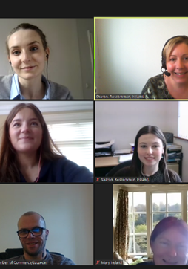

Kick Off Meeting
The partners had their first kick off meeting on the 19th April 2023. They met virtually on Zoom but will be meeting in Person in Poland in November.
Roscommon LEADER Partnership (Ireland) team includes Sharon Johnson, Michaela Deane Huggins, Sara Gannon, Mary Guihen, Martina Earley and Rachel Glynn
Momentum Marketing Services (Ireland) team includes Laura Mangan
Northern Chamber of Commerce (Poland) team includes Jacek Wojcik
The Vision Works (Germany) team includes Erika Nepp
https://projectdare.eu/

